Slide 1
Texas Policy Sharing Group
Statewide Portal for Enterprise Cybersecurity Threat, Risk, & Incident Management
(SPECTRIM)
Notes:
The Texas Policy Sharing Group enables SPECTRIM portal users from different state agencies and institutions of higher education to share their policies with one another, while maintaining the option to keep some policies restricted to your organization.

Slide 2
Request Membership
To enable sharing functionality, users need to be added to the policy sharing group.
Method #1: Submit a Support Request in the SPECTRIM System
Request Type: Account Changes
SPECTRIM Admins will verify with DIR and add the Texas Policy Sharing Group privileges
Method #2: Email GRC@dir.Texas.gov with request to be added to the policy sharing group.
NOTE: All group members have the ability to share policies and view shared policies. It is up to the agency ISO/IRM to determine their organization’s user privileges.
Notes:
SPECTRIM admins will need to add you to the group before the option to share a policy or view other shared policies is available. To request membership, you can open a support ticket in the portal or send an email to GRC@dir.Texas.gov. All requests to be added to the group must come from the agency’s ISO, IRM, or their specific delegate for approval. It is important to be cognizant of any potentially sensitive information before electing to share content externally.

Slide 3
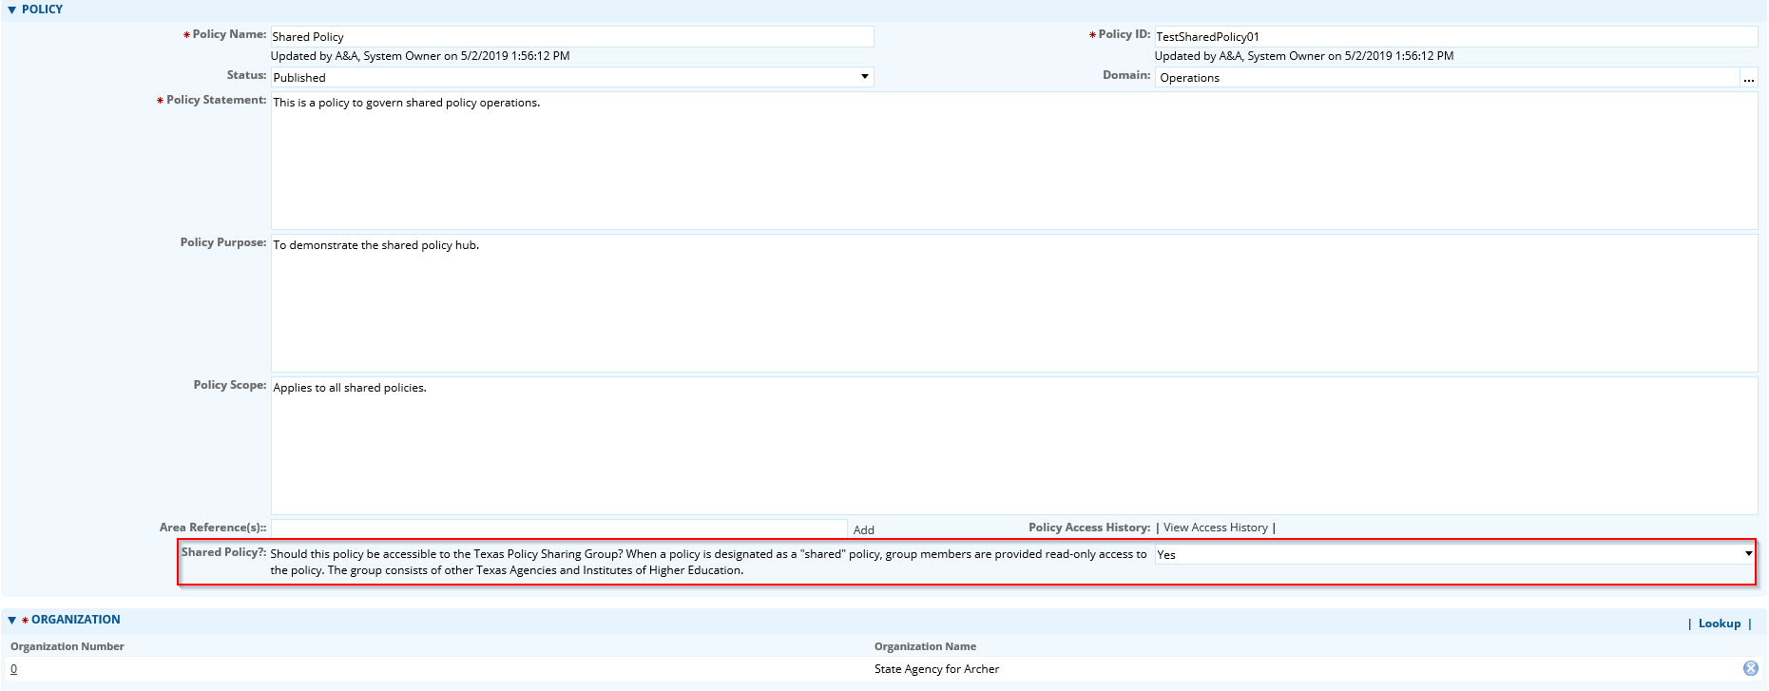
Adding a Shared Policy
Notes:
Once approved, an additional field will appear when adding a new policy. To share a policy, simply respond “Yes” to the Shared Policy? Field under the Policy section when creating the policy record.

Slide 4
Viewing Shared Policies
Notes:
Additionally, a new selection will appear on the policy management dashboard after joining the group. To view all other shared policies, click the “View All Shared Policies” hyperlink on the dashboard. The list of policies will display with individual hyperlinks to the record and additional details.

Slide 5
Policies as Attachments
Notes:
The system also supports the sharing of attachments. If you maintain policies in a separate system, word docs, or another file format you can elect to just upload the content under the Attachments section of the policy record. Tip: use the required policy informational fields to indicate the policy content is in the attachment section for download. It is also helpful to use clear naming and ID conventions so other users can better browse and find pertinent content.

Slide 6
Contact
GRC@DIR.TEXAS.GOV

