Slide 1
Statement of Work (SOW) Guide v1.0
The purpose of this process document is to guide a State Agency user of the Statement of Work (SOW) Portal.

Slide 2
Introduction to SOW Process
The SOW Portal / Application is designed to facilitate the submission of Statements of Work (SOW) to DIR for review and approval. This is a multi-step process.
Refer to the next slide for a visual of this process
Visit https://dir.texas.gov/it-solutions-and-services/buying-through-dir/statement-work-sow to learn more about:
Understanding a SOW
Project Management Methodologies
Templates and Guides

Slide 3
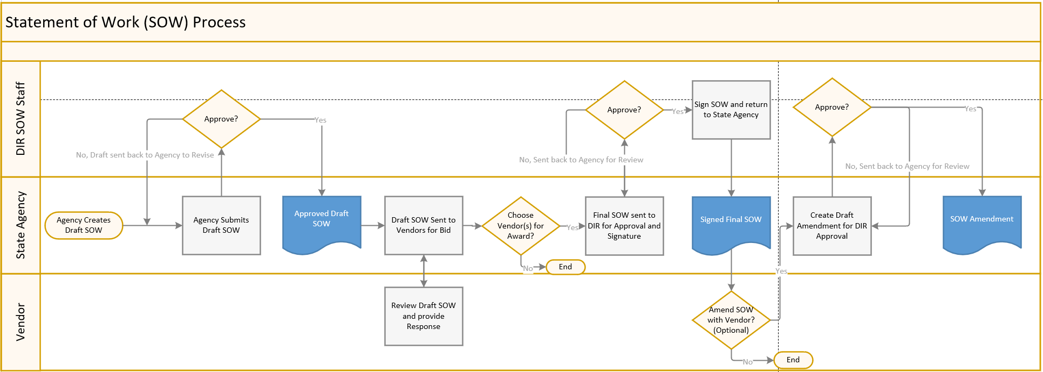
SOW Process
Notes:
The process starts with an agency user submitting a draft SOW to DIR. DIR will work with the agency with edits as needed until approved. The Agency then sends the draft SOW to the approved vendors for bids. The Agency then reviews and selects the winning response(s). The final SOW (for each selected vendor if there are multiple awards) is then sent to DIR for approval and signature. DIR will again work with the agency with any edits prior to approval and signature. Once complete, the signed Final SOW will be sent to the Agency. If at any time an amendment has been made for the final SOW, the Agency must submit the Amendment to DIR for review and approval.

Slide 4
Accessing SOW Portal
SOW Portal has been optimized for Chrome and Firefox (Internet Explorer is not supported)
Navigate to the DIR Website and click on ‘Sign In’ Button
Click on the Customer SOW Portal tile
Click ‘OK’ to accept terms for restricted access dialog box

Slide 5
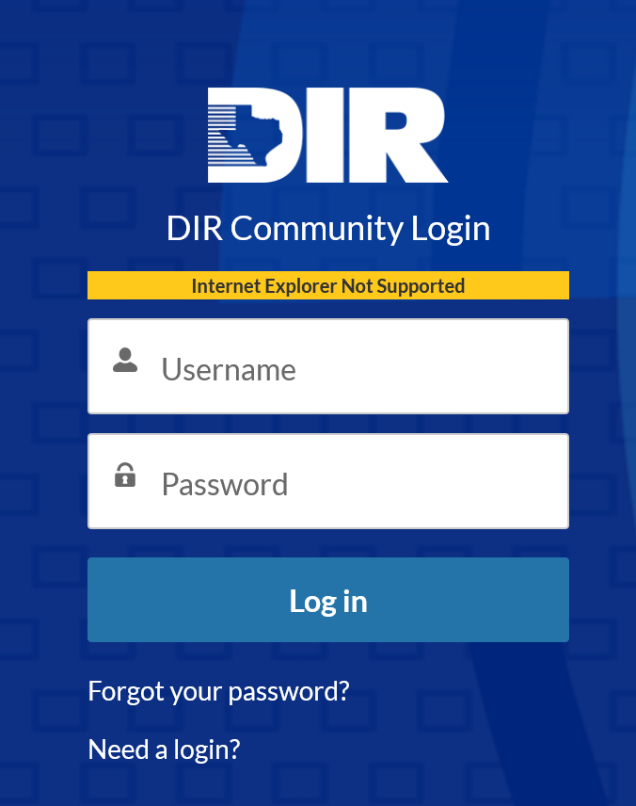
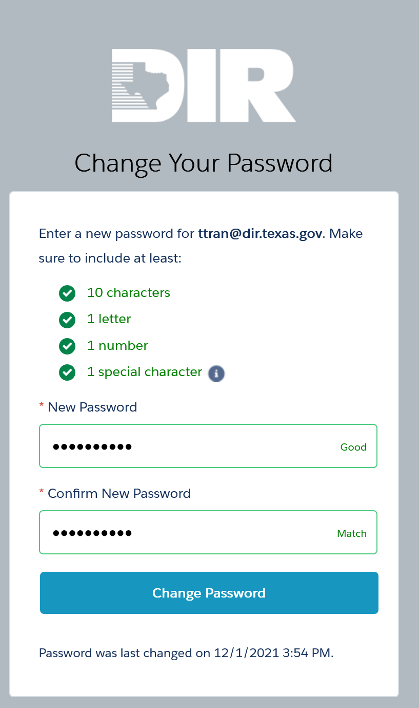
Accessing SOW Portal (cont.)
Enter your credentials to access SOW Portal
Users may see a screen to change password upon first use
Click Forget Password or email identity.support@dir.Texas.gov with questions

Slide 6
Requesting Credentials
Credentials may only be submitted by SuperUsers or IRM (Information Resource Manger)
Email to identity.support@dir.Texas.gov
Requests will be reviewed by DIR staff
Please provide your agency’s name, your Full Name, Job Title, Phone number, and Email.
Allow 2-3 business days to process.

Slide 7
SOW Home Screen
The community portal will list other portals (such as the Exemption Request portal or ITSAC Portal) that you have access to
Select the Portal link to access it
At any time, click on the DIR Community Portal tab to return to your Home landing screen to access other Portals

Slide 8
Submitting a Draft SOW
Click on Submit Draft SOW
Provide SOW Information
SOW Name
Estimated Value (Full lifetime value)
SOW Scope
MIRP? Yes/No
Expedited Request? Yes/No
Choose Technology Categories that apply
Select the Contracts that will be sent the SOW
Upload all relevant files for DIR Review

Slide 9
Review/Withdraw Draft SOW
Once a draft is submitted, you will receive a confirmation email summarizing your draft SOW including the SOW ID#
To review your draft, click on draft SOW ID
At any time, you may upload additional documents to DIR for review
At any time, you may withdraw your SOW from review with DIR
Notes:
Throughout any review process step, please click on the SOW ID and make any updates needed based on feedback from DIR by uploading new documents.

Slide 10
Submitting a Final SOW
Once your draft SOW is approved by DIR, you will receive an approval email
You are then authorized to send your SOW to the approved list of Vendors
Following execution of the final SOW by the state agency and vendor(s), submit the signed SOW(s) to DIR for its signature.
DIR department will review and determine whether it will be signed or if additional information is required first.
Notes:
Depending on the award of the SOW, there may be multiple Final SOWs submitted awarded to each vendor. Please submit a Final SOW for each awarded contract agreement.

Slide 11
Submitting an Amendment to a SOW
Navigate to the Final SOW (Note: Status must be Signed and Closed)
Be sure to choose the correct Final SOW by reviewing the data
Click on Submit Amendment
Add new contract Value (if applicable)
Add new End date (if revised)
Include comments
Amendment will be reviewed by DIR
Notes:
During the life of the SOW, inform DIR of any amendments. These will be reviewed by DIR.

Slide 12
Questions?
Contact identity.support@dir.Texas.gov with questions regarding accounts and logging into the SOW Portal
Correspond with SOW@dir.Texas.gov with questions regarding your SOW submissions

