Slide 1

Navigating DIR Services and Solutions
April 12, 2019
Sponsored by

Slide 2
Introduction to Topic
As procurement professionals, we are challenged with meeting stakeholder demands
  Understanding of market offerings emerging technologies
  Getting stakeholders what they think they need
  Speed and ease of acquiring products and services
How many of you…
Just the other day…

Slide 3

Speaker Background: Hershel Becker
Chief Procurement Officer
Texas Department of Information Resources
Hershel.Becker@DIR.Texas.gov | (512) 475-4617
Joined DIR July 2016
Responsible for procurement and contracting functions
12 years with Office of Attorney General
Over 30 years of experience in public and private sectors providing technology-related services to the great state of Texas

Slide 4
Learning Objectives
Understand
DIR’s Role
in Technology Planning
and Guidance
Learn how to
Navigate
Information Technology (IT)
Offerings

Slide 5
DIR Overview
Policy & Planning
Cooperative Contracts
“Do it Yourself IT”
Bulk Purchasing
Leverage “Known” volume for additional statewide price discounts
Shared Technology Services
“Outsource”
- Application Services
- Security Services
- Telecommunications
- IT Strategic Planning
- Enterprise Solution Services
- Strategic Sourcing
Pre-negotiated master contracts
- Texas.gov
- Open Data Portal
- Infrastructure
goods and services
for technology
Notes:
Here is a high level overview of DIR IT Services, this picture gives you a visual of how the DIR service model might be able to work for you depending on your specific needs.

Slide 6
Eligible DIR Customers
Local Government (6200+)
  Cities
  Counties
  Public School Districts
  Municipalities
  Junior College Districts
  Special Purpose Districts
Texas State Agencies and Institutions of Higher Ed (183)
Other Organizations
  Assistance Organizations
  Electric Reliability Council of Texas (ERCOT)
  Lower Colorado River Authority (LCRA)
  Private Schools
  Private or Independent Institutions of Higher Education
  Volunteer Fire Department
  Public entities outside Texas
Notes:
This list shows the possible universe of DIR customers, especially for procurement opportunities. However, not every program area/function serves all of these organizations. As we explore the different DIR functions, we will indicate the relevant customer base.

Slide 7

DIR Shared Technology
Services
Notes:
Skip:
Today we are going to start with the Shared Technology Services DIR offers.

Slide 8
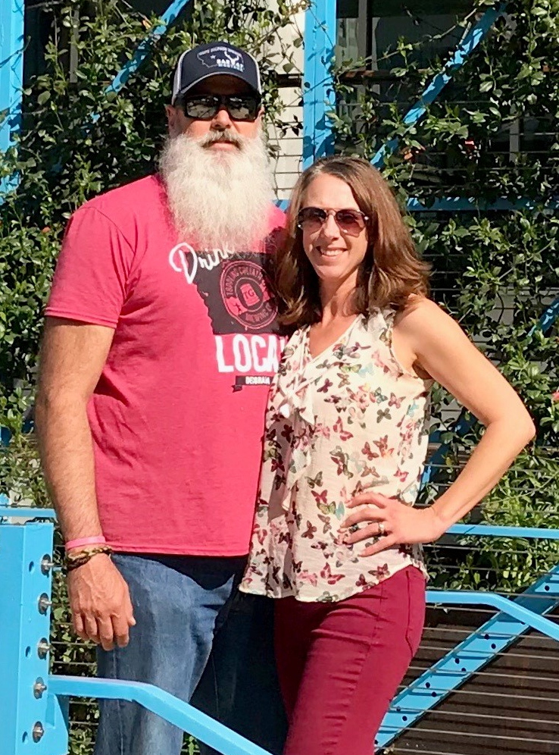
Speaker Background: Skip Bartek
Assistant Director, Enterprise Contracts
Chief Procurement Office
Skip.Bartek@DIR.Texas.gov
With DIR since 2009
Assistant Director Enterprise Contracts
Over 30 years of experience in telecommunications
15 years of State service in various Contract Management roles

Slide 9
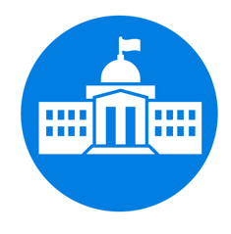



“Do it Yourself” or Outsource
“Do it Yourself IT” pre-negotiated master contracts for IT goods and services
Cooperative Contracts
(Co-op)
Eligible Customers
Shared
Technology
Services
(STS)
  Outsourced Managed
  Services where DIR manages the Service Providers
Notes:
You can recall a version of this image from earlier, This image is highlighting the differences between Shared Technology Services and the Cooperative Contracts.

Slide 10



Shared Technology Services Goals
Enable agencies to modernize their IT
Develop and deploy new services and solutions
Extend the reach of the shared technology services program based on business needs and values to all eligible customers
Optimize and integrate delivery of IT services
Relevance To:
Benefits To:
Our Customers
Customer Service Efficiency Agility

Slide 11
Shared Technology Services Model
Customers
  Increase Service Offerings
  Leverage Investment in model
  Increase Service Quality
  Reduce Statewide Costs
Marketplace
Service Management
IT Business
Management
Retained IT Organization
Operations Mgmt
DCS
Texas.gov
MAS
MSS
ODP
DIR Shared Services
Notes:
Marketplace:
Allows current and prospective customers to learn about and order DIR Shared Technology Services.
Service Management:
Comprehensive ITIL-based management of services provided by Shared Service Providers.
IT Business Management:
Visibility, measurement, analytics, governance, strategy – managing the services that are provided to Customers as a business.
Operations Management:
Knits together operational services of service providers, allowing them to work together efficiently and effectively.

Slide 12
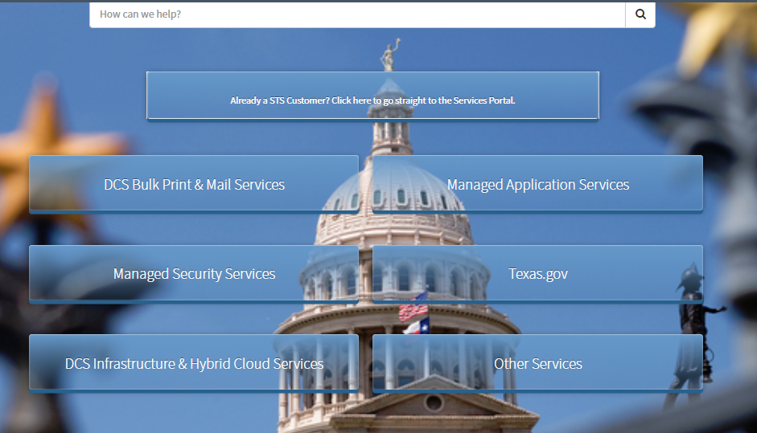
Shared Technology Services Portal
https://dirsharedservices.service-now.com/dir
Notes:
When you first navigate to the Shared Technology Services External Portal this is what it looks like. Each Service Component has its own box to select.
We are going to go to the Data Center Services box first, it is located in the lower left side.

Slide 13

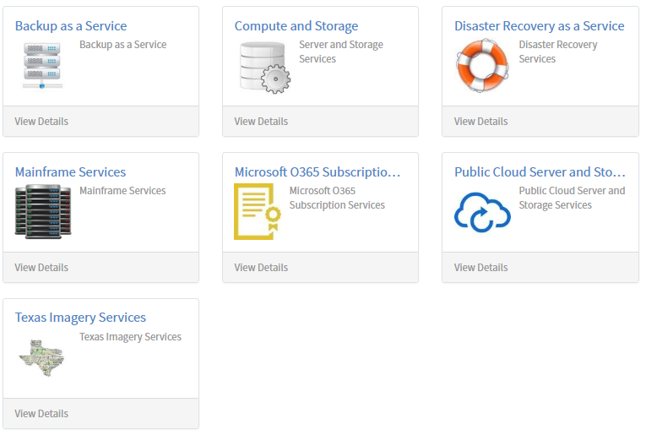
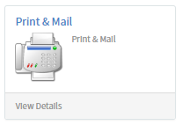
Data Center Services (DCS)
DCS is part of the State of Texas’ long-term strategy to improve government, reduce costs, and increase return on investment in information technology.
Notes:
DIR provides consolidated data services to public entities, primarily state agencies.
Enables Texas state agencies to share costly data center infrastructure, reduce focus on IT operations, and therefore concentrate on their core business
Provides mainframe, server, network, data center, and print/mail services
Delivers services in legacy agency data centers while consolidating operations to the two regionally diverse state data centers
Supports most of the largest state agencies, while providing the flexibility to deliver services to smaller customers as well.
Data Center Services are procured through DIR, which provides ​statewide leadership and oversight for management of information and communication technology for all state agencies and universities.
DIR provides contract management and oversight functions for DCS contracts, including:
Serving as a liaison and escalation point between customer agencies and the service providers
Interpreting the contracts on behalf of the state
Processing invoices and payments

Slide 14

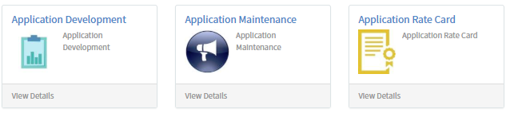
Managed Application Services (MAS)
The MAS Application Development and Application Maintenance are optional, additional service towers to the State of Texas’ Statewide Technology Center (STC) program
Notes:
The MAS program is comprised of three (3) Service Components, each with distinct statements of work. DCS Customers may request services to provide application remediation, transformation, development, and/or maintenance work efforts.
Each service component provides appropriate resource staffing to meet customer needs:
Hourly Rate Card resources allows customers to select application resources by skill set
Application Development services support milestone-based customer development and modernization efforts
Application Maintenance fixed-cost services are delivered based on customer-defined requirements and project specifications

Slide 15

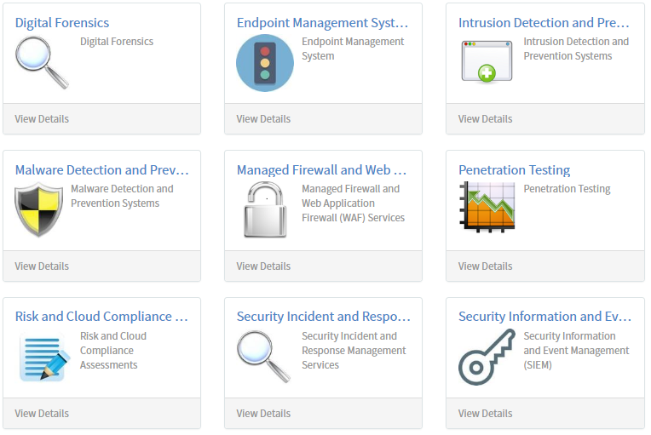
Managed Security Services (MSS)
Managed Security Services (MSS) provides data security through 3 distinct offerings:
Security Monitoring and Device Management (SMDM)
Incident Response
Risk and Compliance
Unlike MAS, Infrastructure does not have to reside in state’s data center to use these services
Notes:
SMDM Services manage and monitor security devices, which includes managed firewalls (including web application firewalls), host-based intrusion prevention systems, endpoint device management, intrusion detection/prevention systems, and malware detection/prevention systems. SMDM also includes Security Information and Event Management, threat research and analysis, and Security Operations Center (SOC) services. SMDM includes the installation, configuration, and management of associated equipment.
Incident Response Services assist Customers in the event of a security incident. Services include response to and resolution of security incidents (e.g., damaging events, computer intrusions, service disruption, security compromises, and inadvertent data disclosure or loss) and digital forensics, (e.g., performing recovery and investigation of material or artifacts found in Customer’s digital device). Incident Response Services also include proactive security response preparedness through development of security response plans.
Risk and Compliance Services help the Customer identify, remediate, monitor, and manage enterprise risks through Services such as controlled penetration testing and security vulnerability assessments. Risk and Compliance Services also assist Customers in validating and meeting compliance requirements of state, federal, or industry regulations.

Slide 16

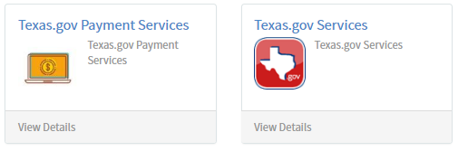
Texas.gov Program Services
Texas.gov program services include payment processing, custom application development and support, customer service, marketing, and analytic reporting.
Notes:
Texas.gov is the official website for the State of Texas providing a single point of access to varied state, county and city government services, and allowing citizens to access government services on-line. Additionally, the Texas Veterans Portal and the Wide Open for Veterans website are operated through the Texas.gov program. Only Texas state agencies and other entities defined as customers in the agreement between DIR and the vendor(s) (Master Service Agreements) are eligible to participate.
The Texas.gov program offers:
Application Development – Build online services that feature plain language, 100% accessibility and a mobile optimized design.
Customer Service, Marketing, and Analytics – Provide 24/7 assistance to constituents, receive site and transactions analytics for online services and receive best practices on how to improve adoption for Texas.gov services.
Payment Processing – The secure, PCI-compliant payment products allows for online and over-the-counter payments for Texas government entities.
Technology and Operations – Services include management of infrastructure, hosting, networking, quality assurance, and security.

Slide 17
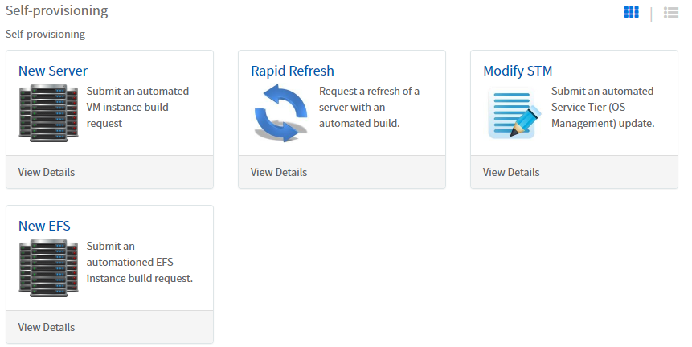
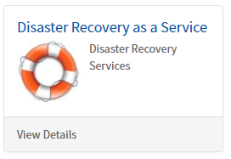
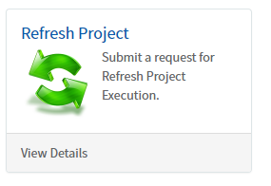
Data Center Self-provisioning
v
v
Notes:
Once you are an established DCS customer, you can self-provision using the “Market Place”.

Slide 18

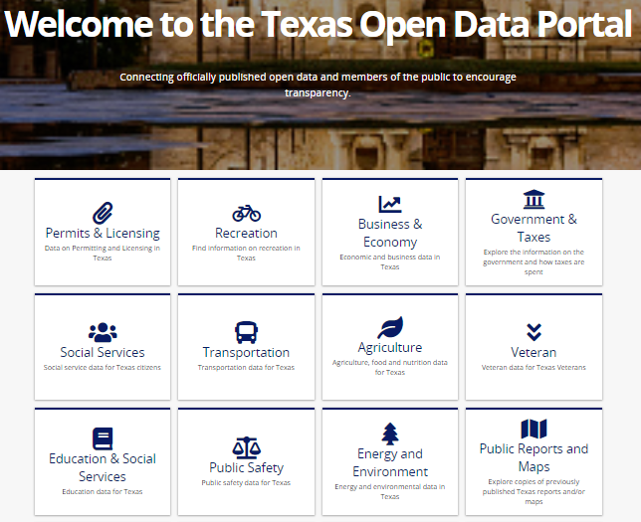
Open Data Portal
Available to DIR customers to post public data
DIR provides use of the Open Data Portal to customers at no charge
https://data.texas.gov/
Notes:
The ODP provides a secure, cloud infrastructure that DIR customers can use to share open data through a centralized portal for the constituents to which they serve thus creating greater government transparency. Since the passing of SB 79 in the 85(R) session agencies can direct public Information requests (PIRs) to a machine readable, publicly accessible website so that requesters can "self-serve" their data needs. This model allows for greater flexibility and availability for constituents as well as greater efficiency for DIR customers.

Slide 19

Communications Technology Services
DIR provides a wide variety of telecommunications services to
eligible customers throughout the State.
DIR provides these services through operation of major and secondary networks, and through numerous contracts for communications-related services
Telecom serves DIR customers in three (3) ways:
  Capitol Complex Telephone System (CCTS) designed for agencies in the Capitol Complex
  Texas Agency Network (TEX-AN) including Voice and Data offerings
  Other Telecom Services including Wireless, Conferencing, and Managed Services
Notes:
DIR’s Communications Technology Services (CTS) helps publicly funded organizations procure voice, data, video, wireless and Internet services.
DIR provides a wide variety of telecommunications services to eligible customers throughout the State. DIR provides these services through operation of major and secondary networks, and through numerous contracts for communications-related services. Telecom serves state and local government agencies and institutions of higher education in three (3) ways: (through bulleted list above)
Note: CCTS is primarily for Agencies Only

Slide 20
Capitol Complex Telephone System (CCTS)
CCTS is a centrally managed telephone service for 90 Austin-area state agencies, including each house of the Legislature and the legislative agencies within the capitol complex.
DIR administers the system to support the services.

Slide 21



TEX-AN
Texas Agency Network (TEX-AN)
Voice​ – Local, long-distance, and toll-free telephone service; and
Data​ – Broadband, Internet, multi-protocol label switching (MPLS), Wi-Fi, and small office/home office (SOHO).
Our experienced DIR Telecom Solutions Team can help you select and order the solution that best meets your business needs. We can also check on the status of an existing order.
Notes:
All state agencies are required to use the Texas Agency Network (TEX-AN) for telephone, internet, data, and video services.
DIR Telecom offers an expansive portfolio of voice and data services through TEX-AN. Since TEX-AN pricing is negotiated with the full-volume buying power of the State of Texas, DIR offers highly competitive rates and service levels that are far more favorable than what state agencies would typically be able to negotiate. Texas state agencies are required to procure the following services through TEX-AN, but they are also available to other government entities in the State of Texas.
For your convenience, TEX-AN services are billed as part of your monthly Telecom Consolidated Bill​.

Slide 22
Telecommunication Services
Other Telecom Services
Wireless Services:
Mobile satellite voice equipment (satellite phones);
Pagers;
Wireless equipment (cellphones, smartphones, accessories, wireless air cards, etc.); and
Wireless voice and data services​.
Conferencing Services:
Audio Conferencing;
Video Conferencing;
Web Conferencing; and,
Webcasting.
Managed Services:
Management of call-processing architecture;
Call Center or Contact Center Services;
IVR/Auto-Attendant;
Phone Systems Management (PBX, key system, etc.) or Integration;
Network Optimization; and
Management of Voice and/or Data Networks.
Notes:
If a telecommunications service is offered by DIR, a state agency must purchase the service through DIR or must request and be granted a waiver before procuring the service through an avenue other than DIR.
DIR contracts with vendors to provide Other Telecom Services such as wireless, conferencing and managed services. All state agencies are eligible. Telecom contracts have highly competitive rates and service levels.
Texas Government Code § 2170.051.

Slide 23
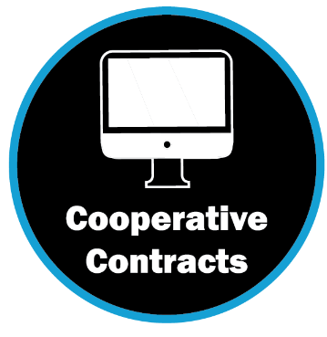
Cooperative Contracts
Program
Software
Hardware
Technology
Training
SOW &
Exemptions
Review
Technology
Services
Bulk Purchase
IT Staffing
DBITS
Notes:
Tom:
The Cooperative Contracts program is what most purchasers think of when talking about DIR.

Slide 24

Speaker Background: Tom Hay
Contract Manager, Cooperative Contracts
Chief Procurement Office
Tom.Hay@DIR.Texas.gov
10 years with the state
Joined DIR in 2011 from TRS
Responsible for RFOs, negotiations, amendments, and reviews customer exemption requests
Training for both customers and vendors
Private sector experience with coop contracts as a vendor

Slide 25
“Do it yourself” or Outsource
“Do it Yourself IT” pre-negotiated master contracts for IT goods and services
Cooperative Contracts
(Co-op)
Eligible Customers
Shared
Technology
Services
(STS)
  Outsourced Managed
  Services where DIR manages the Service Providers
Notes:
You can recall a version of this image from earlier, This image is highlighting the differences between Shared Technology Services and the Cooperative Contracts.

Slide 26



Cooperative Contracts Benefits
Create Savings
Leverage the state’s buying power to lower prices
Contain best value
Bulk Purchase Initiative
Streamlines Purchasing Process
Reduces purchasing and contract cycle time
Reduces duplicate efforts
Access to Historically Underutilized Businesses
Benefits for Vendors
Simplifies sales process for vendors
Access to public entities
Approximately $1.8 Billion in sales per year
Notes:
Create savings – in addition our intent in offering similar products and services on multiple contracts is to build competition into the program. SB 533 thresholds.
Streamline the purchasing process. Coop CMs are sometimes in negotiations for months with vendors over terms and conditions. Imagine the inefficiencies if each DIR customer had to do so.
Highlight the effort expended by multiple resources to procurement the same items. Cooperative contracts reduces that effort and allows a customer to focus on other mission critical tasks.
Contract Managers who procurement and negotiate with many large companies such as AT&T, Amazon, Oracle ensure that the terms and conditions negotiated in our cooperative contracts are in the best interest of the entire state of Texas for all of our customers.

Slide 27
DIR Cooperative Contracts FY 18
FY 18 = $1.81B
$208.3M Savings
Notes:
In FY 2018, customers purchased $1.8 Billion of products and services through Cooperative Contracts, resulting in $208.3M in cost avoidance
The pie chart presents FY 18 sales through the program by customer group
Education (K-12) makes up the largest percentage of sales at almost 33%, followed by Local Governments at almost 25%, then State Agencies at 23%, Higher Ed at just over 18%, and the remainder from Assistance Organizations and Out Of State Customers
First half of FY 2019 – Local Gov’t = 30%, K-12 = 26%, State agencies = 25%, Higher Ed = 17%, OOS = 1.6%, Assist Org = .1%. Savings of $230M.

Slide 28

Cooperative Contracts Products
Computers
Software
Networking Equipment
Printers & Copiers
Surveillance Cameras
Data Storage
Digital Photography
Accessibility Products
Projectors
Security Products
Videoconferencing Equipment
Classroom Interactive Products
Body Cameras
Drones
Disaster Recovery Products

Slide 29

Cooperative Contracts Services
IT Staffing Services
Technology Based Training
End-User IT Outsourcing (Seat Management)
Managed Document Output
Deliverables Based IT Services (DBITS)
IT Security Services
Comprehensive Web Development
Cloud Managed Services
Cabling Services
Telecommunications Services:
  Wireless Voice and Data
  Pagers
  Internet
  Video
  Audio Conferencing
  Cable Modem and DSL
  Interpreter Services – over the phone

Slide 30
IT Staffing
  Information Technology Staffing Augmentation Contracts (ITSAC) provide for temporary IT Staffing services.
    Categories include:
    Developer Analyst
    Developer
    Software Test Analyst
    Technical Writer
    Business Analyst
    System Analyst
    Database Architect
    Data Warehouse Architect
    Database Administrator
    Enterprise Architect
    Project Manager
    Project Lead
    Network Engineer
    Network Administrator
    Help Desk
    Technical Support
    OCM Analyst
    IT Communication Coordinator
    IT End User Trainer
    IT Contract Manager
Notes:
Two methods of procurement:
Competitive process where DIR ensures that all threshold requirements are met, by soliciting ITSAC vendors
Best value method – Do-it-yourself method - where an agency must meet the requirements on their own

Slide 31
IT Staffing Solicitation Process
  ITSAC Competitive Solicitation Process is easy to follow and lets DIR be the conduit for the solicitation from the eligible vendors.
  Submit an IT Staffing Services Request Form
  DIR uses that form to create the solicitation document
  DIR sends the solicitation to the eligible vendors under the ITSAC contracts and receives the responses
  DIR sends the compiled responses to the customer to begin their evaluation and interviewing process.
  The Customer sends DIR the results of their selection process with the selected candidate information.
Notes:
By using DIR’s ITSAC process, DIR becomes the conduit for the solicitation process. DIR manages the contact with the eligible vendors and organizes the responses with the candidate information and then sends it to the requesting customer for their selection process. Once selected, the customer manages the contract with the vendor for their selected candidate.

Slide 32

Bulk Purchase
DIR leverages the state’s purchasing power to negotiate competitive discounts on information and communications technology products and services to governmental entities.
Future Initiatives:
Computer Hardware and peripherals
Initiatives recently concluded:
Box Software
Hardware
DocuSign
Salesforce
GovQA
Tableau
$32M in Savings
Notes:
Article IX, Rider 9.04, “Information Technology Replacement,” in the General Appropriations Act (85R) states that when appropriate, agencies and institutions of higher education shall participate in hardware and software bulk purchasing facilitated by the Texas Department of Information Resources.
DIR facilitates these purchases through its Cooperative Contracts Program. While state agencies are required to comply with certain spending limits under typical Cooperative Contracts purchases, S.B. 261 (85R) exempted state agencies from the spending limits and thresholds for purchases made under a DIR Bulk Purchase Agreement.
Allows DIR to negotiate deeper discounts using pre-established Cooperative Contracts. These discounts typically last over a negotiated period of time.
DIR customers can not only take advantage of those discounts, but the Bulk Purchase initiatives simplify the procurement process because state agencies are not constrained by purchasing thresholds.
State Agencies realized over $10M in additional savings through the bulk purchase agreements for computer and software purchases totaling $22M in FY17 and FY18 for a total savings of $32M

Slide 33
Deliverables Based IT Services (DBITS)
  DBITS contracts provide deliverables-based, outsourced systems integration or application development projects
Application Development
Application Maintenance and Support
Business Intelligence (BI) and Data Warehouse
Enterprise Resource Planning (ERP)
Independent Verification and Validation (IV&V)
Information Technology Assessments and Planning
Project Management
Technology Upgrade/Migration and Transformation
IT Procurement Assistance
Notes:
Deliverables-Based IT Services (DBITS) contracts provide project-based IT services. Use DBITS contracts to meet your organization’s IT project goals including developing a new IT application, upgrading a legacy system, or for IT procurement assistance. Choose from one of the nine competitively bid DBITS categories to meet your needs.
DBITS Contracts should NOT be used for the following:
Procurement of products (hardware and software) only
Subscription licensing
Hosting services
Hourly rate services (ITSAC)
DBITS services over $5 million for state agencies or $10 million for non-state agency DIR customers

Slide 34
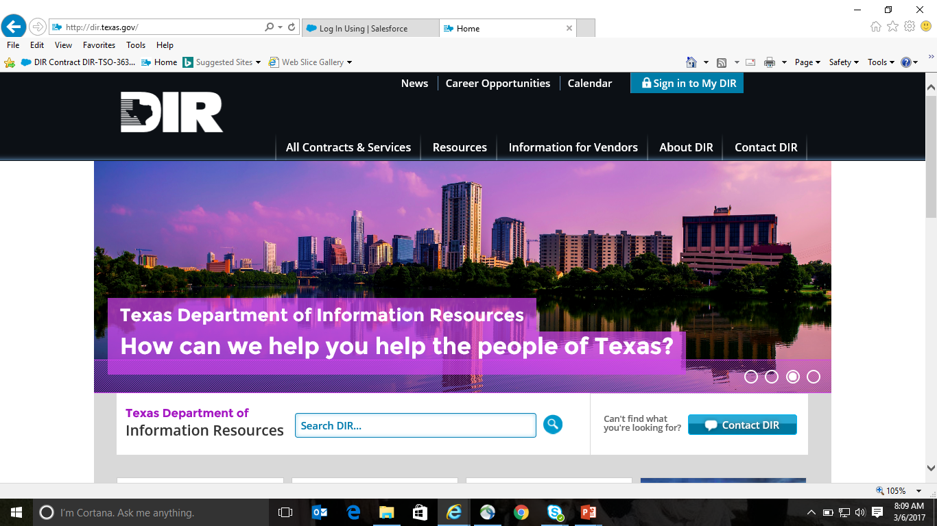
Let’s go to DIR’s page!
34
Notes:
There is a hyperlink embedded in the Texas part of the “D” at the top (DIR), click it and it will open the website.
Talk them through the layout of the website including the difference in the search bars:
Search DIR will give you results on any item where the keyword is found. For example if you type in cloud you may get results from agency board meetings or resources such as white papers.
If you will be using the site to search contracts, I recommend clicking on all contracts and services and then bookmarking that page and using the “Search all Contracts” search bar. The keyword search will be filtered directly to contracts.
Use this time to navigate and show them how to search for a contract and also the layout of the contract structure to include Appendix C and how that ties to the vendor’s website; how to narrow down searches; how to find e-rate eligible vendors (for education only)
Search for E-Rate by typing in “rate” you get 215 results; go to vendor type and you get filter that takes you to 86; pull up a contract and show the E-Rate symbol

Slide 35
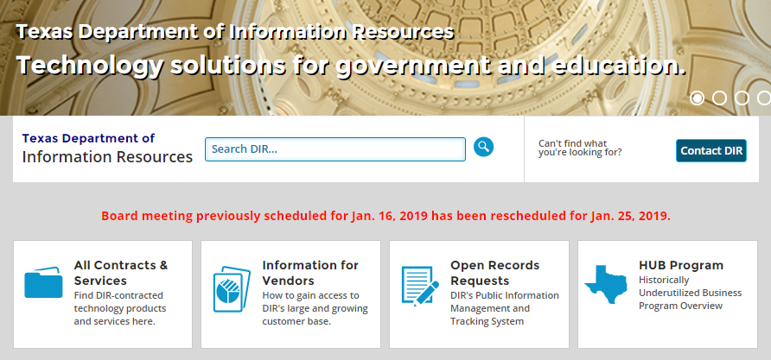
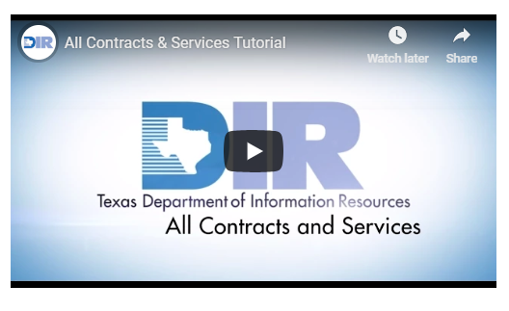
All Contracts & Services Tutorial
For additional information about navigating DIR’s contracts, watch the video located at the bottom of the “All Contracts and Services” page.
Notes:
If that tour was a bit fast or if you need a refresher…
We have a video at the bottom of the All Contracts and Services webpage that walks you through how to navigate DIR’s offerings and how to search the contracts to find the products you are looking for. You have to scroll down to the bottom of the page to find the video.

Slide 36
Cooperative Contracts Exemptions
Don’t See what you need to purchase?
Coop Exemption Review Process
  Gov’t Code, §2157.068 requires state agencies to purchase hardware, software, and technical services through DIR’s cooperative contracts.
  Ask DIR if you can’t find what you are looking for and we will help find it. If we don’t have it, follow the exemption request process.
  The exemption process also helps DIR know what our customers need and want. If a couple of customers want similar things, DIR may be able to procure a contract for those items and services.
Notes:
Highlight that this is for the Coop contracts and that DCS and Texas.gov have a separate exemption process.
If a government entity wants to procure an item through an avenue outside a DIR contract or service (i.e. any Cooperative Contracts, TEX-AN, CCTS, Other Telecom Services, or other program areas such as Texas.gov), the agency must first obtain an exemption from DIR. Exemption processes are explicit. To learn more, simply click on the "+" symbol next to "Exemption Overview" to reveal the exemption processes for:
Cooperative Contracts
Telecom
Texas.gov
Data Center Services(DCS)

Slide 37
DIR Exemptions
An exemption request is utilized when an agency wants to procure an I.T. item through an avenue outside of a DIR contract or service.
  Cooperative Contracts Blanket Exemptions
  Cooperative Contracts One-time Exemptions
Although an agency may be exempt from using the Cooperative Contracts program, it may need to consider requesting other DIR exemptions.
  Data Center Services Exemption
  Telecom Exemption
  Texas.gov Exemption

Slide 38
Exemptions Required
Cooperative Contracts
Required to procure an item through an avenue outside of the DIR contracts and services program
Data Center Services
Required for all DCS customers to request temporary exemptions from use of DCS consolidated IT infrastructure and Services
Texas.gov
Required for all licensing transactions and infrastructure components of Texas.gov including the payment gateway and eGrants system
Telecommunications
Required to procure an item through an avenue outside of CCTS, TEX-AN, or Other Telecom Services
Notes:
DCS - if an agency is contemplating a SaaS solution outside the DCS program, an approved exemption is required. Because technology is constantly changing, all exemptions are temporary and will be periodically re-evaluated to determine if DCS Program services can be used.
Agencies within the DCS program are required to have approved DCS exemptions in addition to any exemptions that may be needed or may have already been approved through the DIR Cooperative Contracts program.
TDG –
Texas Government Code, Chapter 2054, Subchapter K. Electronic System for Occupational Licensing Transactions, lists the agencies that must participate in theTexas.gov licensing framework and remit subscription fee payments to Texas.gov to cover costs for using the licensing framework, the payment engine and credit card fees.
Texas Government Code, Section 2054.113(b), states "A state agency may not duplicate an infrastructure component of TexasOnline unless the department approves the duplication.” The identified components that may not be duplicated are (1) the payment gateway and (2) the eGrants system. DIR, in its capacity as manager of the Texas.gov state internet portal, works with agencies to promote the use of the portal, and where applicable, to determine if an exemption is warranted.
DIR, in its capacity as manager of the Texas.gov state internet portal, works with agencies to promote the use of the portal, and where applicable, to determine if an exemption to any component of the portal program is warranted.

Slide 39
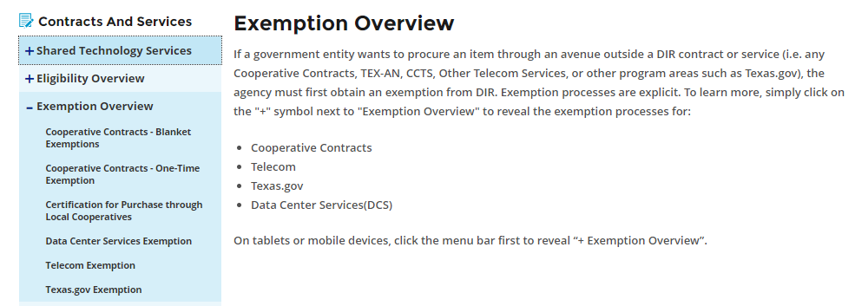
Exemption Overview
To learn more about requesting exemptions from each of the DIR programs see the Exemption Overview page on our website.

Slide 40
Cooperative Contracts Blanket Exemptions
Should your state agency decide to proceed with an IT product or service procurement under a blanket exemption, the procurement must be made in accordance with the exact scope, terms, and requirements specified in the Blanket Exemptions listed below
  Emergency Procurement
  Critical Need
  WorkQuest (TIBH) Set-Aside
  Specific Commodity Codes for Computer/Office Equipment, Accessories & Consumables
  Radio Tower Rental or Lease
  Software Maintenance
  Publication - Subscription Services
  Job Posting Services

Slide 41

Cooperative Contracts Blanket Exemptions
Minimum Threshold Procurements
  State Agencies are exempt from Purchasing IT Commodities through a DIR Contract not to exceed $1,000.00.
Maximum Threshold Procurements
  State agencies are granted an exemption from the requirement to purchase through a DIR contract when purchasing commodity products and/or services when the value of the initial term of the contract exceeds $5 million.
Notes:
If over $5M consider asking for a bulk purchase.

Slide 42
Cooperative Contracts One Time Exemptions
If a Blanket Exemption does not exist, then a State Agency must request a one-time exemption by completing and submitting an Exemption Request Form.
      Exemption Justifications:
        Cost
        Terms and Conditions
        Funding Source Restrictions
        Compatibility with Existing Technology Infrastructure
        Proprietary Restrictions
        Other Circumstances or Requirements

Slide 43

Expedited Exemptions
Expedited Exemptions Request
Expedited Request must include the Exemption Request Form
DIR will process the request within three (3) business days
Request must include a statement from the agency head, or his/her designee
Describe the reason for the expedited request

Slide 44
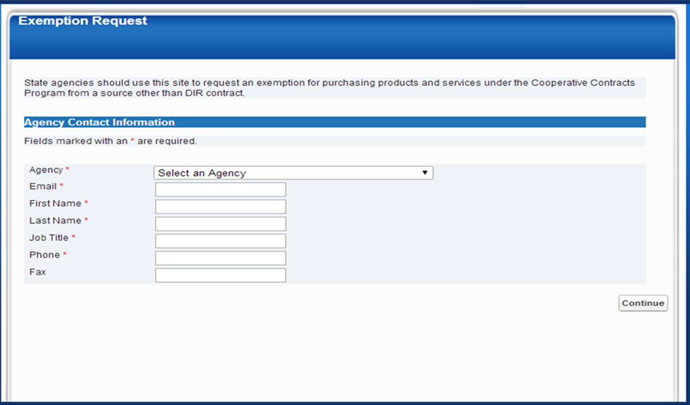
Coop Contracts Exemption Request Portal
Customers will receive a confirmation email from DIR
The assigned waiver number
Date waiver was created and submitted to DIR
Category selected on the waiver
Exemptions can be approved or denied. They may also be withdrawn.

Slide 45

Cooperative Contract Documents
Common Elements
  Contract Document
  Appendix A Standard Terms and Conditions
  Appendix B HUB Subcontracting Plan
  Appendix C Pricing Index (DBITS: Statement of Work)
Additional Appendices (as needed) Examples
  Appendix D Service Agreement
  Appendix E Master Operating Lease Agreement
  Appendix F Statement of Work
Amendments
Use the contract page as your resource to download all contract documents.
Notes:
If Vendor wants you to sign a document , make sure it is one that is included with the contract as an Appendix

Slide 46
Key Contract Document Provisions
Order of Precedence
  Amendments
  In the event of conflict among the provisions, the order of precedence shall be this Amendment Number 4, then Amendment Number 3, then Amendment Number 2, then Amendment Number 1 and then the Contract.
Contract Term
Software License and Service Agreements
Shrink/Click-wrap License Agreement
Authorized Exceptions to the Contract
(the last paragraph before the signature)

Slide 47

Appendix A: DIR Terms and Conditions
Appendix A includes terms and conditions that govern the conduct of DIR and Vendor during the term of the Contract .
Survival Clause – Life beyond the contract
Use of Order Fulfillers – Authorized resellers
Termination Clause – Termination for Cause
Performance Meetings – Corrective Action Plan

Slide 48

Beyond DIR Terms and Conditions
Customer Specific - Terms and Conditions
Purchase Order Term
Acceptance Criteria
Invoices
Payment
DIR Contract Number
Audited Financial Statements
Security Requirements
Confidentiality
Insurance
CJIS
HIPAA
FERPA
Notes:
DIR contracts contain the terms and conditions that protect the state of Texas and its DIR customers. DIR CM’s keep up with trends and risks and negotiate T&Cs that are most relevant to today’s IT climate. These terms and conditions can not be eliminated or weakened by a customer, however customers can add existing T&Cs and strengthen ones that are already in place when needed for their organizational purposes.
Examples
Increased need for insurance based on the project- cyber insurance; increased policy values
Unique security requirements – such as access to buildings, for public safety requirements on how tools/equipment should be secured
Unique requirements for education such as FERPA; healthcare – HIPPAA; law enforcement – CJIS requirements
Note: some additional T&Cs may have upfront cost (example increased insurance requirements or restrictions to access building during certain times, etc…)

Slide 49

Cooperative Contracts
DIR Price Negotiations
DIR negotiates pricing based on state’s purchasing power to establish minimum discounts for IT commodities
Customers may purchase any volume at established pricing
Customer Price Negotiations
Use Open Data and Reporting to see what others have paid
Maximize competition by soliciting multiple price quotes
Take advantage of DIR Contract Manager’s familiarity with the vendor and contract
Notes:
Customer Price Negotiations
Use Open Data and Reporting – allows you to see previous pricing and discounts based on similar products
Maximize competition by submitting additional price quotes – we have multiple contracts with vendors for the same or similar products and often the master contract has resellers. By going to more vendors you may find vendors who are more willing to be aggressive in their pricing to win your business
Utilize the DIR Contract Manager – The DIR contract manager is listed for each active contract. They can be an asset as you prepare for negotiations or if you have questions. Please contact them if you have questions about terms and conditions or anything else that may be helpful to you as your procure from our contracts.
Ask… - The simplest but most often overlooks way to obtain better pricing
Always ensure the DIR Contract Number is on the quote – vendors have different agreements with different entities. To ensure that you obtain DIR pricing and contract protections, this is a helpful requirement

Slide 50
Good to Know
Term of your Engagement
  Customers purchase/agreement survives DIR Contract, as long as it was arranged before DIR Contract Expires
  Be aware of any areas where Vendor seeks to vary from DIR terms; can always enhance Customer’s terms but not diminish or conflict with DIR contract terms
  DIR contract terms generally have priority over almost all vendor documents (note exception for third party license agreements)

Slide 51
Maximizing HUB Utilization on
DIR Contracts
Notes:
Lynn

Slide 52

Speaker Background: Lynn Hodde
Lynn Hodde
HUB Program Manager
Chief Procurement Office
Lynn.Hodde@DIR.Texas.gov
Joined DIR August 2013
Responsible for HUB Compliance for DIR and DIR Customers
Over 22 years of state service with the General Services Commission (GSC), Texas Building and Procurement Commission (TBPC), Texas Department of Agriculture (TDA), Texas Comptroller of Public Accounts (CPA), The University of Texas at Austin, The University of Texas System, and Texas A&M University

Slide 53
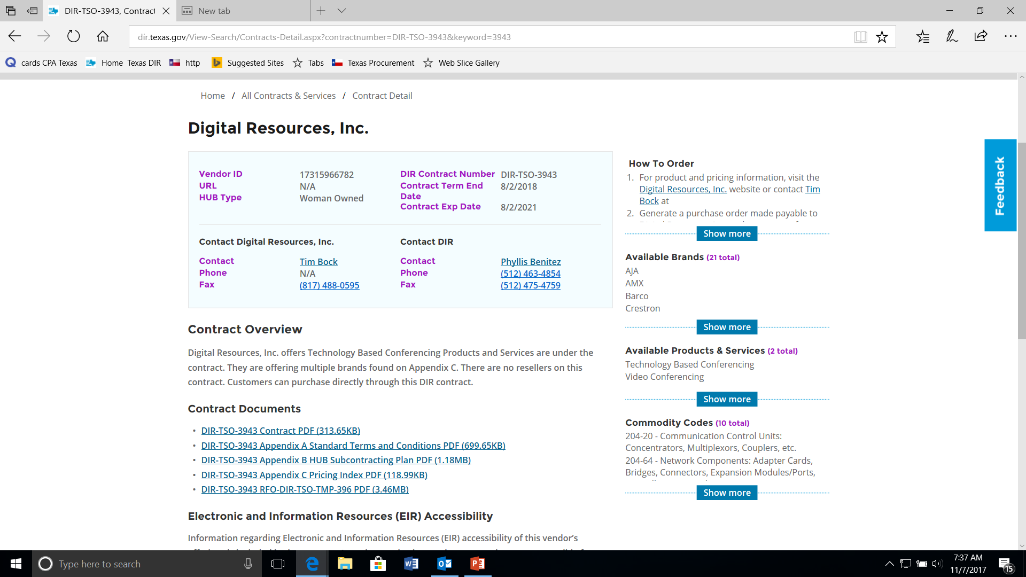
HSPs and DIR Contracts
What does an HSP on a DIR Contract mean?
Where do I find the HSP?
What if there is no HSP?
Notes:
Every DIR Contract has an HSP tied to it. When we bid out an RFO, a HUB Goal is assigned to that RFO, respondents are required to submit an HSP, an HSP review is conducted and a HSP is approved or failed. Once the evaluations and negotiations have completed and the vendor is awarded a contract, their contract documents are posted to their contract page. Included in those contract documents is their HSP. You can access the HSP on any and all of our contracts. On occasion you might not be able to find the HSP for a contract. Reasons for this 1. it’s an expired contract, 2. It’s a new contract, and documents are being uploaded to the page. If you have a situation where you can’t find an HSP, please contact myself or Theresa and we will assist you in your search.

Slide 54
HUB Goals on DIR Contracts
HUB Goals on DIR Contracts
Other Services
26.0%
Commodities
21.1%
Notes:
DIR adopted the statewide HUB goals based on the disparity study methodology on the following factors:
*Appendix K of the 2009 Texas Disparity Study and reviewed the methodology for establishing goals with those baselines;
*MGT of America who authored the study requested specific census data to match State procurement categories. Without knowing what specifically was requested of the US Census, to update any baselines that would not be comparable.
*The average of HUB goals based historically by year. Those averages were lower than the goals based on the disparity study methodology.

Slide 55

Resellers Vs. Subcontractors
What is the difference?
Customer
DIR Contract Prime
DIR-TSO-3943
Subcontractor A
Subcontractor B
Subcontractor C
Purchase Order
Customer
Reseller
Notes:
Resellers identified on a contract can accept purchase orders and invoice customers. If you utilize a HUB, you will show 100% HUB credit on that expenditure.
If subcontractors are listed, they can’t accept PO’s, this is where you need to step in and identify what subcontractors they are going to use on your Purchase Order specifically.

Slide 56

What does the HSP mean?
HSP values = DIR Contract Value
Not your Purchase Order Value
WHAT?
Notes:
The HSP that is attached to a contract is their HSP for the life of the contract. Could be 1, 2, or 4 years. DIR Contracts are awarded based on a quantity of 1. The percentages will really depend on their volume of sales.

Slide 57


What does this mean for me?
Identify your agency/university IT Purchasing process
Get ahead of the Purchase Order being issued
Seek HSP Clarification

Slide 58
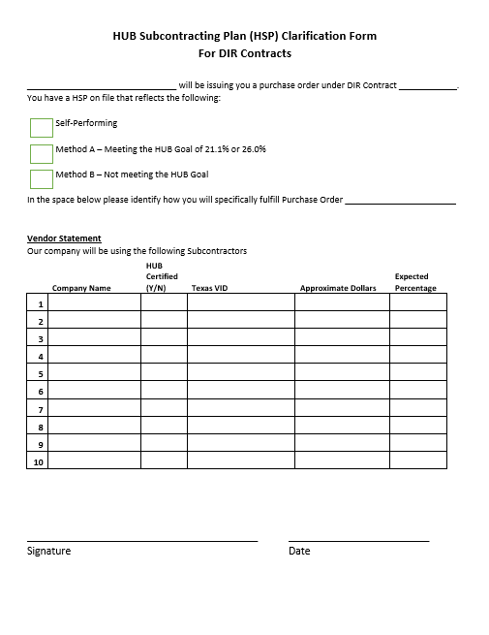
DIR HSP Clarification
Notes:
Walk through the form. This is just a guide, it can be amended to fit your needs.

Slide 59
HUB Coordinator Involvement
IT Service or Product Need is Identified
DIR Contract Search begins, DIR Contract Identified
HUB Coordinator is made aware of “PENDING” purchase
HUB Coordinator reviews online HSP
HUB Coordinator contacts contract holder to seek clarification
Specific dollar amounts and percentages are identified
PAR Tracking = Higher HUB Participation

Slide 60
What really happens…….
IT Service or Product need identified
Purchase Order issued
HUB Coordinator identifies they were excluded from the procurement process
No clarification obtained

Slide 61
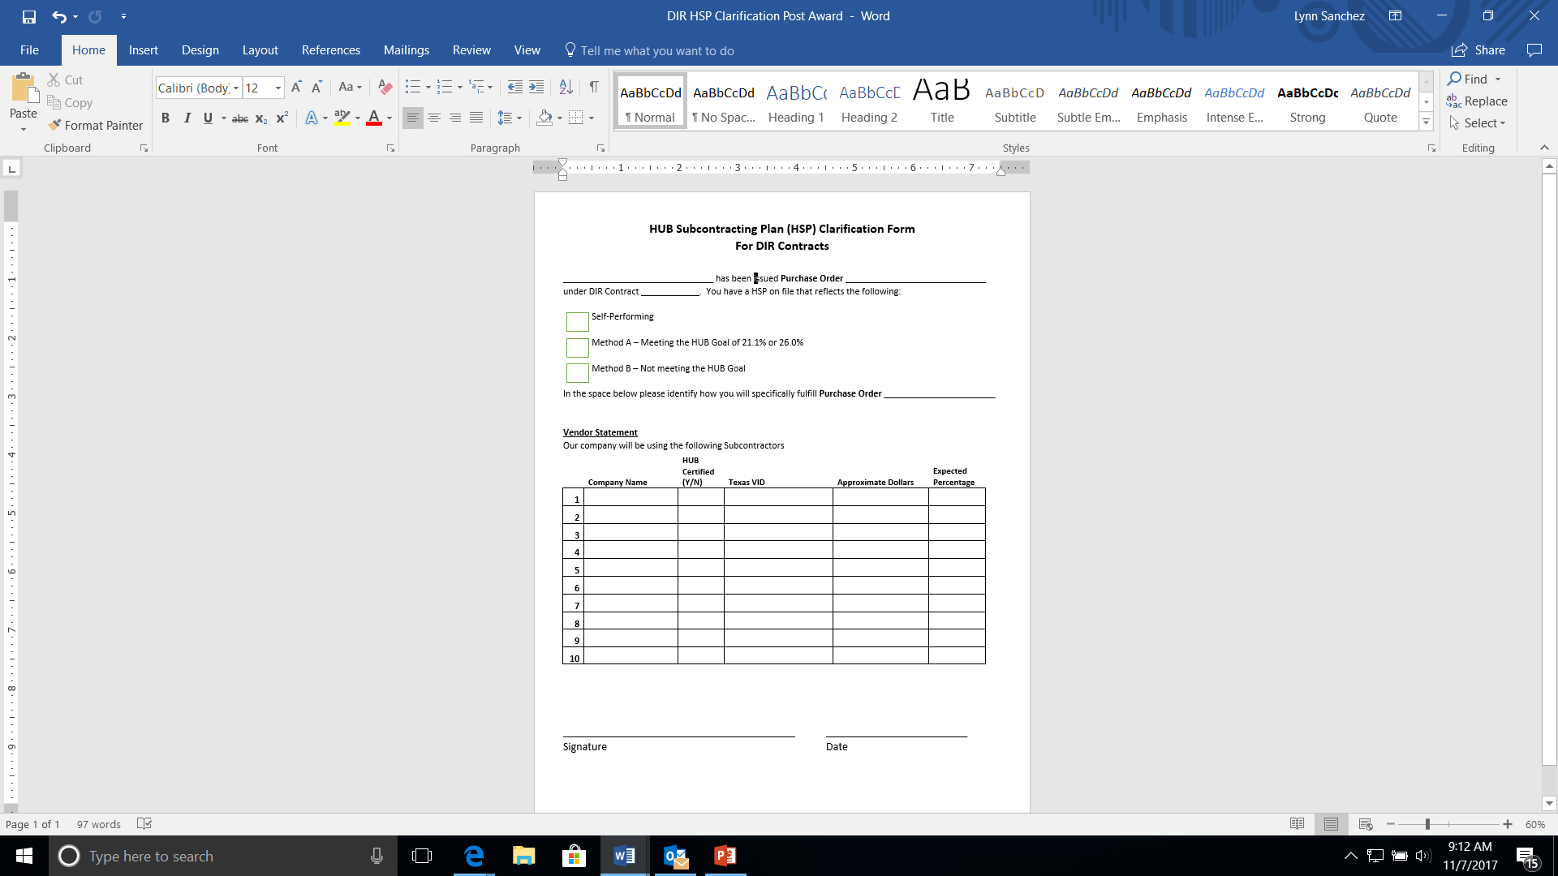

It’s Not Too Late
You can always request clarification from a vendor

Slide 62
Progress Assessment Report
Vendors are required to submit a PAR on a monthly basis to their customers.
Appendix A, 9. Contract Administration, B. Reporting & Administrative Fees, 3. Historically Underutilized Businesses Subcontract Reports
  a) Vendor shall electronically provide each Customer with Vendor’s relevant Historically Underutilized Business Subcontracting Report, pursuant to the Contract, as required by Chapter 2161, Texas Government Code. Reports shall also be submitted to DIR. b) Reports shall be due in accordance with the CPA rules.

Slide 63

HSP vs. PAR Discrepancies
What do you do if you have a subcontractor identified on a PAR that is NOT on the vendor’s HSP?
Notes:
If you have identified a subcontractor on a PAR Report that is not on the DIR HSP, stop and contact the vendor and cc the DIR HUB Office. The vendor MUST update their HSP Immediately with DIR prior to any additional work being completed. The vendor is in Non-compliance with their contract. Once the updated HSP has been approved you can proceed. The vendors contracts state Vendor may add or delete Order Fulfillers throughout the term of the Contract upon written authorization by DIR. Prior to adding or deleting Order Fulfillers, Vendor must make a good faith effort in the revision of its Subcontracting Plan in accordance with the State’s Policy on Utilization of Historically Underutilized Businesses. Vendor shall provide DIR with its updated Subcontracting Plan and the Order Fulfiller information listed in Section 7.B.1.a above.

Slide 64

Contacts
Get to Know DIR’s HUB Team
Lynn Hodde – Lynn.Hodde@dir.texas.gov or 512-463-9813
Theresa Williamson – Theresa.Williamson@dir.texas.gov or 512-475-4638
dir.hub@dir.texas.gov

Slide 65
Determining the Appropriate IT Procurement Method
Notes:
Colleen

Slide 66

Speaker Background: Colleen Berkley
Colleen Berkley
Director of Procurement Services
Chief Procurement Office
Colleen.Berkley@DIR.Texas.gov
15 years with the state
Joined DIR in 2016 from OAG
Responsible for Shared Technology Services (STS) procurement, procurements for DIR internal-use contracts
Serves as an advisory role for the Innovative Procurement Lab (IPL)

Slide 67
Using Commodity Codes
Classification codes with AIS component are noted with asterisk (*) on NIGP Commodity Book maintained on Comptroller’s Office website
For those with AIS designation, agency Contract Developers and other purchasing professionals are required to use DIR contracts
Questions about the use of certain classification codes or AIS designations may be directed to DIR or the Comptroller’s Office Statewide Procurement Division (SPD)
Notes:
Agencies are required to use contracts established by DIR to obtain Automated Information Systems (AIS), basically anything with a technology component (computers or telecommunications), unless DIR grants them an exemption
If you aren’t sure that what you are buying has an AIS designation, check the Comptroller’s website. They have noted all AIS components with an asterisk. If you can’t find it there, you can call DIR or the SPD to ask for help.
Alpha searches do not show the asterisk. Only the numeric index indicates items available on DIR contracts.

Slide 68
Determining Procurement Method
“Do it Yourself IT” pre-negotiated master contracts for IT goods and services
Cooperative Contracts
(Co-op)
Eligible Customers
Shared
Technology
Services
(STS)
  Outsourced Managed
  Services where DIR manages the Service Providers
Notes:
Here’s a quick call-back to a slide you’ve seen earlier. Once, you’ve determined that you are buying an IT product or service, you should then ask yourself how responsible your agency wants/needs to be for the procurement and contract management.

Slide 69

Contract Options
Cooperative Contracts
  The Customer manages procurement and contract
  Customers can negotiate for “right-sized” solutions
  Customer must maintain procurement and contract records, including a copy of the DIR master contract
  Customer manages any vendor performance issues during the term of the contract
Notes:
Cooperative contracts require Customers to enter into contracts directly with vendors. Going down the cooperative contracts route, you will be responsible for the end to end management of the procurement and the resulting contract, even though the procurement process is greatly simplified. This provides you with the ability to choose the best fit for you agency and to negotiate your own rates and terms within the bounds of the master Coop contract.

Slide 70

Contract Options
Shared Technology Services
  Customer contracts directly with DIR (for DCS customers, might be simple amendment to existing IAC)
  DIR is responsible for procurement and contract documentation
  Limited to one-size-fits-most Service structure
  DIR serves as point of escalation for vendor issues
Notes:
There may be administrative documentation that the customer is responsible for maintaining, like the invoicing information.
Skip has already run through the list of services available through the Shared Technology Services program. Just know, DIR is adding more services in the future, so check periodically to see if we have something that fits your needs.

Slide 71
Tips When Using Coop Contracts
You can:
  Reduce the amount of time it takes to award a contract
      Consider using IFBs for commodities, and award solely on low price
      Consider using a “ranked” evaluation rather than scoring. Ranking is another form of scoring and can reduce the amount of time evaluators spend per response
    Protect sensitive information through a targeted solicitation
      Consider requesting minimum qualifications from interested vendors under the applicable category in advance of issuing the SOW, then send to only those vendors who responded and that qualify
      Based on thresholds, consider sending the solicitation to a subset of vendors on the applicable
Notes:
Customers can shorten the length of time for evaluation when using a cooperative contract.
and award processes required under cooperative contracts;
Email from HB – State of Ok – 6 hours to procure off DIR contracts
Consider sending solicitations to all eligible vendors in the category to increase response rates and potentially increase HUB participation
– this is key for sensitive information that you don’t want broadcast to the world

Slide 72

Tips When Using Coop Contracts
You can:
  Increase your HUB utilization numbers by searching Cooperative Contracts for eligible HUB vendors/resellers when deciding what subset of vendors to solicit. Per the Procurement and Contract Management Guide:
    For purchases between $5,000 and $25,000, the agency must solicit from a minimum of three active vendors on the CMBL including two current Texas-certified HUBs
    An agency may supplement the CMBL with State of Texas certified HUBs at any time if the agency determines that it may enhance competition or increase the number of HUBs that submit bids.
This Photo by Unknown Author is licensed under CC BY-SA
Notes:
There is guidance in the Procurement and Contract Management guide stressing the importance of including more HUBs in active solicitations.

Slide 73
Tips When Using STS Contracts
You can:
  Eliminate the need for a procurement to receive services
      Customers can submit Requests for Services, similar to Statements of Work, to receive customized solutions on a pre-competed contract.
      There are no threshold considerations, so larger application builds can be purchased through the Texas.gov or Managed Application Services contracts.

Slide 74

Tips When Using STS Contracts
Consider entering into an Inter Agency Contract (IAC) with DIR for Managed Security Services
  There is no cost for having the IAC until services are delivered;
  In the event of a breach, if an IAC is in place, the vendor can be on-site and helping within twenty-four (24) to forty-eight (48) hours;
  Data protection and security is a hot topic at the Capitol right now – don’t be caught without coverage!
This Photo by Unknown Author is licensed under CC BY-ND
Notes:
Use STS contracts to reduce agency’s overhead required for complex procurement/contracts

Slide 75
Did You Know?
Along with the core service offerings, certain software solutions may be available through Shared Technology Services. Ask DIR for help if you are a current customer looking for something in particular.
DIR can initiate a bulk purchase procurement as long as two (2) or more agencies express interest in the same product/service. Bulk purchases are exempt from the $5 Million threshold requirements.
Rate card services can be purchased from the MAS rate card contract by DCS customers only.
Notes:
Rate Card services are equivalent to the cooperative contracts ITSAC category and staff can be put in place with a very short turn around (about the length of time it takes to perform a background check)

Slide 76

Bottom Line
Shop DIR First

Slide 77

Procurement File Documentation
Notes:
Colleen

Slide 78

Procurement File Documentation
Technology Challenges
  Portal – submitting for Procurement Oversight and Delegation
  Webinars and slides
  Recordings, both audio and visual aids
  Electronic versus hard copy documentation
  HTTPS challenges
Notes:
With the changing technology landscape, there are some challenges to maintaining the proper procurement file documentation.
The new POD portal threw me for a loop when I had to submit the DCS Private Cloud procurement recently. DIR procurements can be complex, and our contracts can consists of numerous documents and exhibits. Last year, with the Multi-sourcing Services Integrator procurement, we had almost 40 separate contract files. If you’ve tried to submit something for CAT review recently, you’ll know that the portal limits the number of files you can submit to 20. Fortunately, DIR had done some work to reduce the number of discreet documents, so for Private Cloud, we only had 1 document that wasn’t submitted – an appendix that contained a list or reports. There were lots of ways to solve this, combining documents, zipping files, etc., but I wasn’t expecting the limitation and we had no documented procedure for overcoming it. Next, when I received the recommendations through the portal, I wasn’t quite sure what the best way was to document the recommendations, work them with the team since they can’t access the portal, then to store the responses we submitted back to CAT.
So CAT does provide approval, CAT solely provides recommendations
Prior to posting an agency must
Comply with recommendations or
Submit written explanation regarding why the recommendation is not applicable to the procurement
The agency’s responses to the CAT recommendation must be kept within the procurement file; again, this was not something that could be exported, and we received 54 recommendations for private cloud – more than fit on a single screen. I copy/pasted the portal page into a word document and I hope that will be enough.
Speaking of technology, at DIR, we strive to use technology whenever possible to enable greater attendance at solicitation events. That mean we use webinars in conjunction with in-person events and we try to record webinars for posting to the ESBD.
This has created some interesting challenges in terms of documentation. Of course, we maintain the slide from pre-solicitation conference. We have physical sign in sheets as well as webinar attendee lists that we have to maintain. These are posted on ESBD, but we also try to collect and post business cards in case the writing on the sign in sheets is difficult to make out.
We keep the webinar recordings. These are typically posted on DIR’s youTube channel, with a link posted to the ESBD. The nice thing about youTube is that it has an auto-caption function that allows us to save some time while being compliant with accessibility laws. Rather than doing a complete transcription of the event in-house, our staff reviews the youTube closed captioning and edits from there. It is a huge time-saver.
We also allow vendors to submit questions via the webinar. In the room, we use a presentation technology, Mentimeter, and require vendors to submit questions that way. Mentimeter keeps all questions anonymous and it creates an electronic record of all questions submitted. We can then answer the questions in the room or defer them to the written Addendum.
There is a bill currently that will require agencies to keep procurement file documents in their native format – that means if something starts off electronic, it must be kept electronic. Does that mean that we will have to have both electronic and hard copy procurement files that contain different information based on the manner in which it was received? Is it okay to scan hard copies and make the electronic copy the document of record? Will that stand up to an audit?
Finally, we are hearing from vendors who have had difficulties accessing documents on the ESBD because their company policy does not allow them to go to an unsecured site – think HTTP vs. HTTPS. Security companies, in particular, have this policy in place, and it is a big challenge when you are trying to get a best in breed security company to respond to a security services RFO.
Keep records of all correspondence received from vendors regarding the solicitation

Slide 79

Procurement File Documentation
Other Challenges
  Evaluation team – anonymous or not?
  Copies of oral presentations - how does this work with live demonstrations?
  Oral presentation sign-in sheets – how do we indicate someone attended via telephone/electronically?
  What happens when technology fails?
Notes:
Cooperative contracts – on the DIR website, you can export an excel spreadsheet based on the commodity code to document what vendors received your documents.
CMBL constant contact list, save supplemental list,

Slide 80
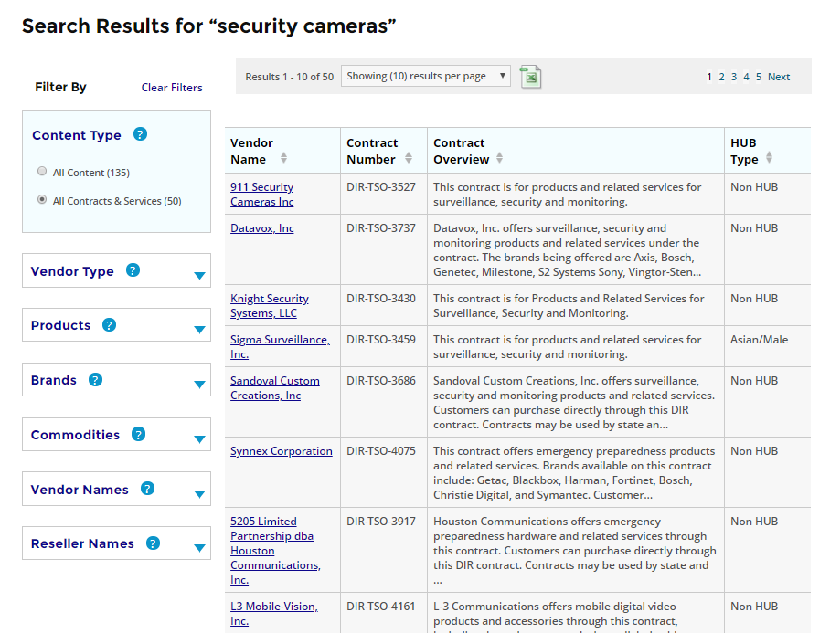
Search Results Export
Notes:
An easy way to capture the list of vendors who offer the item you are procuring is to use the export button at the top of the search results page.
On this spread sheet you will find the vendors and their contact information to which you can send the request for quote.

Slide 81
Collaboration
What do you do?

Slide 82

Cooperative Contracts SOW Review
Notes:
Tom

Slide 83
Cooperative Contracts SOW Review
Statement of Work Review
  Under TAC 212, state agencies are required to submit SOWs to DIR for approval prior to solicitation and prior to contract award for SOWs over $50,000.
  Services Requiring SOW review include but not limited to:​
    Deliverables-Based Information Technology Services (DBITS)​
    End-User IT Outsourcing Services​
    IT Security Services​
    Cloud Services (when an SOW is executed) ​
    Comprehensive Web Development ​
    Complex services such as software or hardware ​customizations, integration, or overall project solutions
Notes:
DBITS- Deliverables based IT services contracts require a SOW to procure, and for State Agencies any SOW with an estimated value over $50,000 must follow DIR’s SOW review process. You can learn more about the SOW process on our website under the DBITS page. We also have templates available to help make the process streamlined and easy to follow.

Slide 84
Threshold Requirements
Up to $50,000 | May directly award contract to DIR Cooperative Contracts vendor(s) or reseller(s)
Over $50,000 but not exceeding $1 million | Must submit request for pricing to at least three (3) DIR vendors or resellers
Over $1 million but not exceeding $5 million | Must submit request for pricing to at least six (6) DIR vendors or resellers
exceeds $5 million | May not enter into a contract through the DIR cooperative contracts program to purchase a commodity item
Initial CONTRACT VALUE
Notes:
If over $5M consider if a bulk purchase agreement is an option.

Slide 85

SOW Review Not Required
  IT Staffing Services
  Support Agreements
  Maintenance Agreements
  Hardware or Software Only Contracts
  Telecom

Slide 86
SOW Process: Draft Submission
1: Agency Submits Draft SOW to DIR
2: DIR Reviews and Consults with Agency
3: DIR Responds to Agency within 30 working days of submission
4: Agency submits Approved SOW to relevant DIR vendor(s)
Notes:
SOW review is a TWO phased process- First Phase is the Draft review
Agency submits the draft SOW through the DIR portal
DIR reviews, and may put the SOW on hold to get clarification from the customer
DIR responds to the agency with either the requirement to add or clarify basic SOW elements or to select relevant contracts or DIR will approve the DRAFT SOW
Once approved, the agency may solicit responses from the contracted vendors selected in the Draft submission

Slide 87
SOW Process: Final Submission
2: Agency and vendor execute final version of SOW
4: DIR reviews, approves, signs and returns SOW to agency.
Agency issues the purchase order to selected vendor.
1: Agency evaluates vendor responses and negotiates final version of SOW
3: Agency sends final signed SOW to DIR for approval. DIR responds to Agency within 3 working days.
Notes:
Phase 2 is the FINAL SOW Submission
1. The agency has solicited relevant contracted vendors for response, has evaluated responses, down selected one or multiple vendors, and negotiated final pricing and terms.
2. The agency obtains the vendor signature on the final negotiated SOW, the agency signs the Final SOW, and submits to DIR through the portal
3. DIR reviews the final: Is the awarded vendor on the original list, did the scope of the approved draft change during vendor negotiations, did the final price exceed the original estimate in a way that different threshold requirements would apply. DIR will consult with the agency and ask for clarification as necessary.
4. Once approved, DIR will sign the SOW confirming review. The agency may now issue the purchase order to the vendor referencing the DIR contract number. PLEASE NOTE: TAC212 states that the DIR signature does not make the DIR a party to the agreement between the agency and the vendor, and DIR will not be responsible for any other state agency's obligations.

Slide 88

SOW Process: Timelines
Draft SOW Review
30 Business Days
Expedited Draft SOW Review 3 Business Days
Final SOW Review 3 Business Days
*Note: Justifications for cost and/or Terms and Condition Exceptions may take longer than 30 days

Slide 89

SOW Process: Amendments
All amendments or change orders, are to be submitted to DIR for approval. This includes any changes to the scope regardless of cost.
Amendments would be submitted through the DIR portal with reference to the original SOW and would follow the same path as the draft and final submissions of the original.

Slide 90
Important Note
  Agencies must
  post all executed SOWs on their websites
  Vendor cannot be paid until DIR signs the final SOW

Slide 91

DIR SOW Templates
DIR has SOW templates for agency use for waterfall and Agile methodologies of project management.
DIR will be reviewing your SOW to ensure the scope is appropriate for the DIR contract(s) selected.
What does that mean?

Slide 92
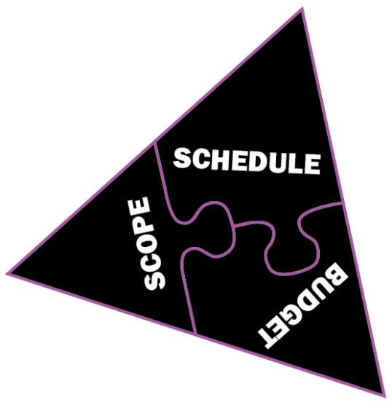

Statement of Work Defined
Statements of Work are legally enforceable agreements to transact business in a combination of scope, schedule and budget
A clear scope, schedule and budget are core
to good planning and effective management
of the Statement of Work
SB 20, Sec. 2157.0685
"statement of work" means a document that states the requirements for a contract, including deliverables, performance specifications, and other requirements, specific to the vendor under that contract …
Notes:
Not only does a SOW provide a commitment for all parties involved in a project, it forms the basic framework of the Contract between the vendor and the agency
In developing the project scope, key questions to ask are:
Who needs to be on the team to make this succeed? Integrate Best Planning Practices – get the right people involved
Can we scope something we can manage?
What features do we need?
Can we identify risks in order to mitigate them?
Can we build elements into the SOW to help us manage?
What methodology best supports the project scope?

Slide 93
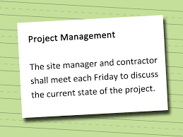
SOW Elements
While a Statement of Work is unique for each project, SOW elements are generally consistent across projects and methodologies:
  Scope of Project
  Roles and Responsibilities
  Deliverables
  Period of Performance/ Schedule
  Performance and Service Levels
  Acceptance Criteria
  Pricing and Payment Schedules/Milestones
  Assumptions
Notes:
Scope – tells the story of your project, provides features
Roles and responsibilities – What will the vendor provide – What will the agency provide
Deliverables - a thing able to be provided as a product of a development process. Could be a report, a document, a software product, a server upgrade or any other piece of an overall project
Acceptance criteria – tied to deliverables – who at your agency will approve the deliverable. What are the conditions of a successful completion of the deliverable?
Period of Performance – what’s the start and end of the project – Do you need a phased approach? What is the expectation of time to completion? Consider the options to extend….
Performance and Service Levels – Example – Building a website. If your website delivers information, it may be acceptable to have a failure that you allow an 8 hour downtime, but for a transactional website like renewing a license or receiving payment 8 hours could be catastrophic for the agency
Pricing and payment schedules – Will you pay at the completion of key deliverables, or in timed intervals, or at the end of the project
Assumptions – something that you think is true – Like a vendor will assume Infrastructure that will be available to a project such as networks and communications tools. Or the agency will assume the vendor has the software tools to complete the project as defined in the SOW.

Slide 94

SOW Elements Cont’
Additional SOW Elements:
  Introduction
  Background
  Submission/Format
  Confidentiality
  Security
  Background Checks
  Reports and Meetings
  Customer Furnished Equipment and Workspace
  Accessibility Requirements
  Additional Terms and Conditions
Preferred Project Methodology
Waterfall or Agile
Notes:
If any development work is involved, confidentiality, security, and accessibility requirements are the more key elements to be included in the SOW.

Slide 95
SOW Writing : Plan Your Approach
What methodology best supports the project scope, goals and objectives?
  Waterfall works well with projects that have “assured predictability”
  Agile intended for projects that require significant software design and development.
Notes:
Waterfall example – an assessment that will result in the writing of a report as the completion of the project.
Agile has been in place since 70’s. And only in the last decade have the Feds started exercising in their procurement initiatives.
Agile projects work well where there is a moderate level of uncertainty and complexity, and agreement on requirements has not been achieved (i.e., intangible requirements, pressure to get a working product to the user urgently, product/service development, IT [software], process development or improvement, periodic upgrades, etc.)1

Slide 96
Waterfall vs. Agile
Fixed: Scope
Fixed: Schedule
Fixed: Budget
Process and tools
Comprehensive
Documentation
Contract negotiation
Following
a plan
Waterfall
Plan Driven
Agile
Value Driven
Individuals and
Interactions
Working product
Team Collaboration
Responding to change
Planned: Schedule
Planned: Budget
Planned: Scope
The waterfall methodology adheres to strict scope definition and delivers to plan, rather than value.
Notes:
Scope is fixed in Waterfall. Works best for assessment projects, road mapping, IT procurement assistance (documents, evaluations, etc.)
Point out PLANNED scope in Agile – which is the scariest element for procurement and contracting folks because it is not fixed. Agile works best for development projects, legacy modernization, application development, etc.
Waterfall – plan driven, and Agile – project/value driven.

Slide 97
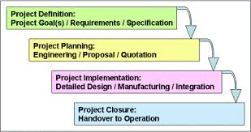
Waterfall Methodology Features
Scope determined and fixed
Complete project planned up front
The final product is delivered to customer for approval
Notes:
Challenges:
Projects become rigid and resistant to change
Focus is sometimes more about the process than the product of service being delivered
Significant amount of up‐front analysis
Early sign off on requirements that might not be fully understood
Cost can be high due to extra effort spent fixing defects and having to rework design

Slide 98

Agile Features
Ability to respond to change is high.
Working product is the primary measure of progress.
Working product with progressively increasing functionality can be shared with customer after each iteration.
Inspect and Adapt is an agile best practice used to capture the idea of discovering emergent requirements
Notes:
Challenges:
Changing the team structure can negatively impact the project
Organizational buy in to the methodology
Changes in scope probable
Need for subject matter experts (SME) on the project team
Involve Contracting personnel on the project

Slide 99
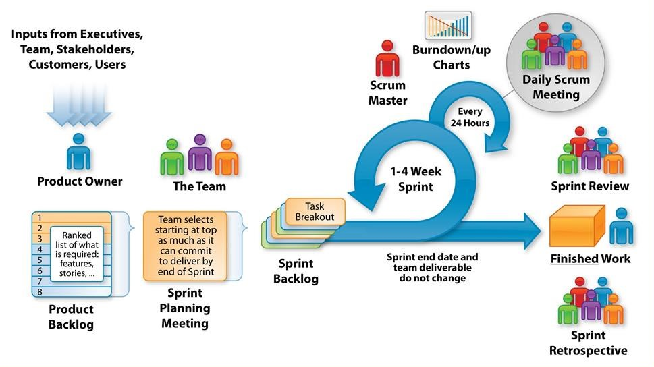
Agile Methodology
The Agile Methodology is based on iterative development, where requirements and solutions evolve through collaboration between self-organizing, cross-functional teams.
Notes:
Agile is an iterative (sprint) process. The project is broken into groups of features that can be completed within a short sprint. At the end of the sprint, there’s a roadshow where all stakeholders determine what is working, what is not, what needs an enhancement, or even features that you thought you wanted on paper, but now are not important. You have something that is working in a few weeks.

Slide 100
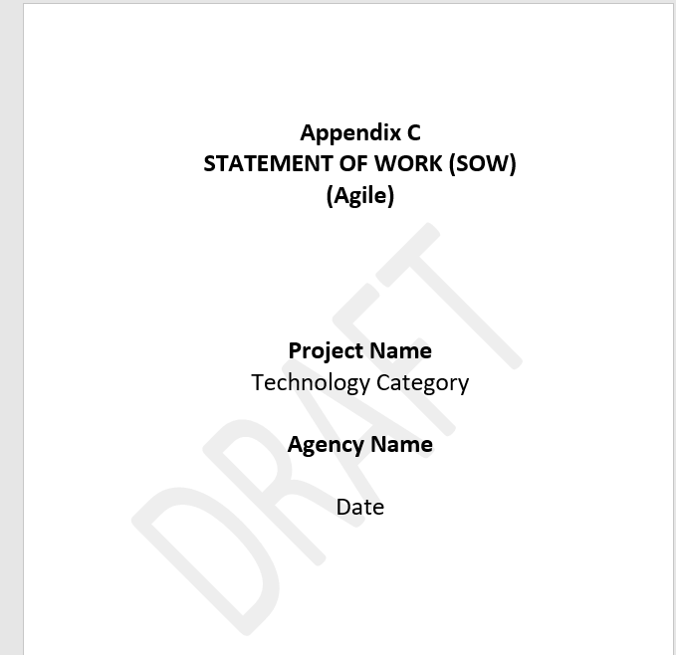

DIR Templates
Screen clipping taken: 3/18/2018 10:59 PM
Notes:
DIR has templates available on our website for both Agile and Waterfall project methodologies

Slide 101
Table of Contents
1.Introduction
2.Background
3.Scope
4.Deliverables
4.1.Sample Content
4.2.Sample Delivery Schedule
5.Reports and Meetings
6.Service Level Agreement
7.Period of Performance
8.Invoices
9.Agency/Vendor-Furnished Equipment and Work Space
10.Additional Agency Terms and Conditions
11.Vendor Response
11.1.Staff Capabilities
11.2.Service Capabilities
11.3.Project Work Plan
11.4.Additional Considerations
11.5.Pricing
12.Schedule of Events and Response Guidelines:
12.1.Question and Answers:
12.2.Point of Contact:
13.Response Evaluation Criteria
14.Response Submission Requirements
Notes:
Just looking at the TOC gives you an idea of what you need to provide.

Slide 102

The Agile SOW: Considerations
Consider a performance based statement of work
Include features of the finished product. (User stories)
Request Vendor Release Plan based on the features and user stories provided in the SOW
Deliverables may equal completion of groups of sprints
Payment schedule is still tied to the “deliverable”
Define Sprint 0 as creation of a prototype or gathering of requirements (user stories)
Multiple awards may be considered
Notes:
Agile projects work well where there is a moderate level of uncertainty and complexity, and agreement on requirements has not been achieved (i.e., intangible requirements, pressure to get a working product to the user urgently, product/service development, IT [software], process development or improvement, periodic upgrades, etc.
Sprint 0 is the baselining of the project. Usually at no cost.
Hershel – speak on multiple awards may be considered.

Slide 103

Useful links
SOW page
https://dir.texas.gov/View-Contracts-And-Services/Pages/Content.aspx?id=42
DBITS page
https://dir.texas.gov/View-Contracts-And-Services/Pages/Content.aspx?id=41
Legacy Modernization Strategy:​
https://dir.texas.gov/View-Resources/Pages/Content.aspx?id=50 ​
QAT:
https://dir.texas.gov/View-Resources/Pages/Content.aspx?id=16
​EIR Accessibility:
https://dir.texas.gov/View-Resources/Pages/Content.aspx?id=36
Security:
https://dir.texas.gov/View-About-DIR/Information-Security/Landing.aspx

Slide 104
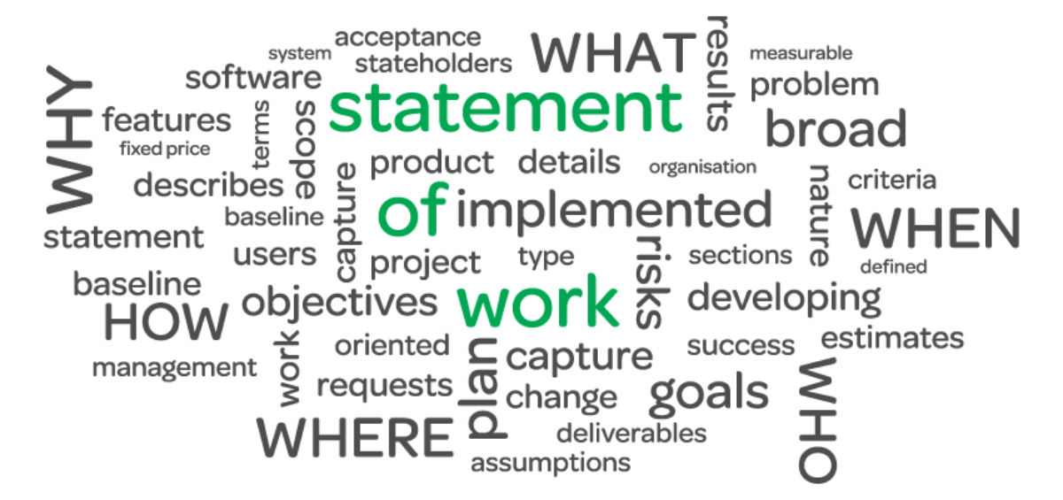
SOW for Hardware Rollout
Think about:
  IT resource availability
  Trash responsibilities
  Staging areas
  Hours of operations (during business hours of after hours)
  Phased rollout vs. big bang
  Security concerns
  Negotiation needs
  Data Transfer
  Data destruction
  Buy-back program
Notes:
Colleen:
Did you know that you can take a few of your old hardrives to NSOC to have it shredded. Not intended for large quantities.

Slide 105

IT Negotiations
Notes:
Colleen

Slide 106

What are negotiations?
Negotiations are discussions between parties to reach an agreement on the services to be performed
They occur after the competitive range has been established
They are intended to allow offerors to revise their proposals in order for the state to achieve best value for its money

Slide 107





What can be Negotiated?
Anything in the contract.
Focus on:
  Requirements;
  Schedule;
  Exceptions;
  Price; and
  Terms/Conditions.

Slide 108


Rules of Negotiations
In negotiations, you can:
  Point out areas where the Response varies from the requirements
  Discuss potential tradeoffs
  Reach agreements (which are then documented in the contract)
  Persuade the offeror to improve pricing/performance in the offer revision
NEVER reveal information from another offer/proposal as a basis of comparison

Slide 109
Top 10 “Rules” for Negotiations
Be prepared!
Don’t negotiate against yourself;
Aim high;
Give yourself room to compromise;
Use concessions wisely;
Be prepared for someone to walk away;
Apply pressure;
Words matter!
Non-verbal communication is important;
Write it down!

Slide 110


Get it in Writing!
If it’s not in the contract, you can’t enforce it;
Verbal understanding won’t be remembered years from now;
No clarity = multiple change orders

Slide 111

IT “Gotchas”
Intellectual Property Rights
Limitation of Liability
Audit Rights
Termination Assistance
This Photo by Unknown Author is licensed under CC BY

Slide 112

Intellectual Property
Things to Consider:
  Know your scope of work (what is being developed new, what might be built on existing platforms)
  Understand the deliverables (work product, customization, configurations)
  License back (royalty free, ongoing updates)

Slide 113

Limitation of Liability
What is the minimum required?
What areas have give?
How sensitive is the data?
What is the worst case scenario?
What is the industry doing?

Slide 114

Audit Rights
SSAE 16 Service Organization Controls (SOC) 2
There are 2 Types of SOC 2 reports
  Type I
    Looks at point in time
    Auditor opinion based on the description of the controls and documentation around them
  Type II
    Report on the description of a service organizations system and the suitability of design and operating effectiveness
    Controls described and evaluated for a minimum of 6 months

Slide 115

Termination Assistance
Lay out what you will need in terms of:
  Time
  Resources
  Support
Be reasonable; termination assistance has a cost

Slide 116
Innovative Procurement Lab
&
Agile Procurement
Notes:
Hershel

Slide 117

Innovative Procurement Lab (IPL)
DIR has established an Innovative Procurement Lab with ultimate goals to:
streamline IT procurements
provide best value solutions through demonstrated vendor performance
We are seeking customers that are interested in experimenting with innovative procurement methods. This is an opportunity to improve IT procurement and contracting practices for your entity and to play an active role in influencing IT procurement practices at a statewide level.
Partner with us today to improve IT Procurement and Contracting!

Slide 118

Agile Procurement
Save Time & Costs
Increase Satisfaction
Meet Procurement Statutes

Slide 119
Key Takeaways about Offerings
  Competitively bid on open market
  Cooperative Contracts
    No agreements needed for in-state DIR customers
    Customers order directly from Vendors
    Historical Sales Data available on Open Data Portal
  Shared Technology Services
    Agreements required for Shared Technology Services
    Customers place orders via DIR Ordering System Portal
119
Notes:
When looking at DIR’s offerings you can be assured that all contracts have been competitively procured on the open market.
DIR has multiple types of contracts for you to choose from, Shared Technology Services contracts and Cooperative Contracts.
Pooling the purchasing power of government and leveraging it to drive down costs and add value to information technology purchases is part of DIR’s core mission.

Slide 120
Current Contracting Initiatives
Posted on DIR’s website under Information for Vendors
  https://dir.texas.gov/View-Information-For-Vendors/Current-Contracting-Initiatives/Landing.aspx
Lists initiatives by procurement stage
  Planning
  RFO Postings
  Electronic State Business Daily (ESBD)
  Evaluation
  Negotiation
  Recent Awards and Each initiative has a brief description, expected phase completion date, and contact information

Slide 121

Resources
DIR Website
  Current Contracting Initiatives
  FAQs
  Webinars
  Templates
  Request for Technology
  Products and Services
Open Data Portal
Join a Mail List [ITSOURCING recommended]
DIR Contract Manager

Slide 122

Questions / Discussion

Slide 123
Contact Information
Thank you
Hershel Becker
Chief Procurement Officer hershel.becker@dir.texas.gov
(512) 475-4617
Skip Bartek
Assistant Director, Enterprise Contracts
skip.bartek@dir.texas.gov
(512) 936-9876
Tom Hay
Contract Manager
tom.hay@dir.texas.gov
(512) 936-7199
Lynn Hodde
HUB Program Manager
Lynn.hodde@dir.texas.gov
(512) 463-9813
Colleen Berkley
Director of Procurement Services
colleen.berkley@dir.texas.gov
(512) 475-4659
This Photo by Unknown Author is licensed under CC BY-NC-ND

