Slide 1
DIR Connect 2016 Advanced Purchasing
Using the Department of Information Resources
to meet your needs

Slide 2
Agenda
DIR Cooperative Contracts Process
Purchasing Thresholds
Statements of Work
Data and Reports
Negotiating Price
Terms and Conditions
DIR Shared Services
Questions and Answers

Slide 3
SB 20 Threshold Requirements

Slide 4
Statement of Work Required > $50,000

Slide 5
Statement of Work Review NOT Required
Review
REQUIRED
IT Staffing Services
Support Agreements
Maintenance Agreements
Hardware or Software Only Contracts

Slide 6
Data at your fingertips
Leveraging the State of Texas Open Data Portal
And
DIR Custom Reporting

Slide 7
State of Texas Open Data Portal
Texas Open Data Portal
Promote government transparency
Encourage citizen participation
Enable efficient use of public resources

Slide 8
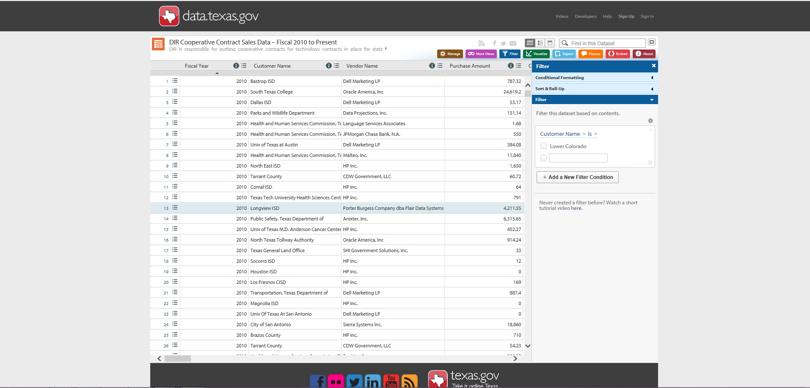
State of Texas Open Data Portal

Slide 9
Open Data Portal

Slide 10
DIR Customized Reports

Slide 11
DIR Customized Reports

Slide 12
DIR Customized Reports

Slide 13
Maximizing the Cooperative Contracts Program
through Negotiation

Slide 14
Cooperative Contracts
Negotiating Price
DIR Price Negotiations
DIR negotiates for a quantity of one
Vendors are required to post their pricing on their website
Customer Price Negotiations
Use Open Data and Reporting
Maximize competition by submitting additional price quotes above the threshold requirements
Utilize the DIR Contract Manager
Ask…
Always ensure the DIR Contract Number is on the quote

Slide 15
DIR Customized Reports

Slide 16
Cooperative Contracts
Customer Specific - Terms and Conditions
Purchase Order Term
Acceptance Criteria
Invoices
Payment
DIR Contract Number
Audited Financial Statements
Security Requirements
Confidentiality
Insurance
CJIS
HIPAA
FERPA

Slide 17
Cooperative Contracts
DIR Terms and Conditions
Survival Clause – Life beyond the contract
Use of Order Fulfillers – Authorized resellers
Termination Clause – Termination for Cause
Performance Meetings – Corrective Action Plan

Slide 18
DIR Shared Services

Slide 19
Shared Services
Foster and promote value by encouraging use of managed technology infrastructure and shared services
Information Security
Texas.gov
Data Center Services

Slide 20
Questions and Answers
Thank you
Dana L. Collins, CTPM, CTCM
Phone: 512.936.2233
dana.collins@dir.texas.gov

