Slide 1
DIR Connect 2016
Purchasing 101
Purchasing Information Technology (IT), Thresholds and Statements of Work (SOW)

Slide 2
IT Procurement
State agencies are required to purchase information technology (IT) commodity items through contracts established by DIR.
There are exceptions:
Agency first obtains an exemption from DIR
DIR procurements do not exceed $1,000
Procurement exceeds $1 million dollars

Slide 3
IT Procurement
Gov’t Code, Chapter 2170 requires state agencies to procure telecommunications services through DIR.
Gov’t Code, §2157.068 requires state agencies to purchase hardware, software, and technical services through DIR’s cooperative contracts.

Slide 4
DIR Contracts
Enterprise Contracts
    Texas.gov (NICUSA)
    TEX-AN NG
    Data Center Services
Cooperative Contracts

Slide 5
Cooperative Contracts
What do they do?
Create savings for taxpayers
Leverage the state’s buying power to lower prices
Contain best value
Optimize the purchase of IT commodities and services
Streamlines process for customers
Simplifies sales process for vendors

Slide 6
DIR Customers
State Agencies
Higher Education
K-12 Independent School Districts
Private Schools
Private or Independent Institutions of Higher Education
ERCOT
Cities
Counties
LCRA
Volunteer Fire Departments
Municipal Water Districts
Out of State Governmental Entities
Assistance Organizations registered with the Texas Facilities Commission or the Texas Comptroller of Public Accounts

Slide 7
Available Services
IT Staffing Services
Instructor Led and Computer Based Training
Seat Management
Managed Document Output
Deliverables Based IT Services (DBITS)
Telecommunications Services

Slide 8
Available Products
Computers – more than 20 brands
Software – more than 1000 publisher titles
Networking Equipment – more than 100 brands
Cloud Services
Printers – more than 25 brands
Surveillance Cameras – more than 60 brands
Data Storage – more than 20 brands
Digital Photography Projectors
Security Products Videoconferencing Equipment Classroom Interactive Products

Slide 9
IT Staffing Services
Developer Analyst
Developer
Software Test Analyst
Technical Writer
Business Analyst
System Analyst
Database Architect
Data Warehouse Architect
Database Administrator
  Project Manager
  Project Lead
  Network Engineer
  Network Administrator
  Help Desk

Slide 10
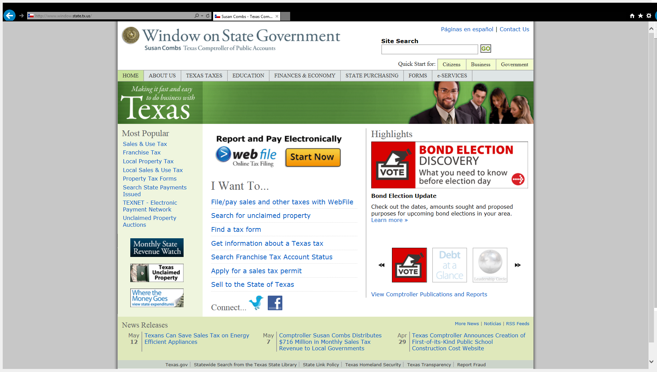
NIGP Codes

Slide 11
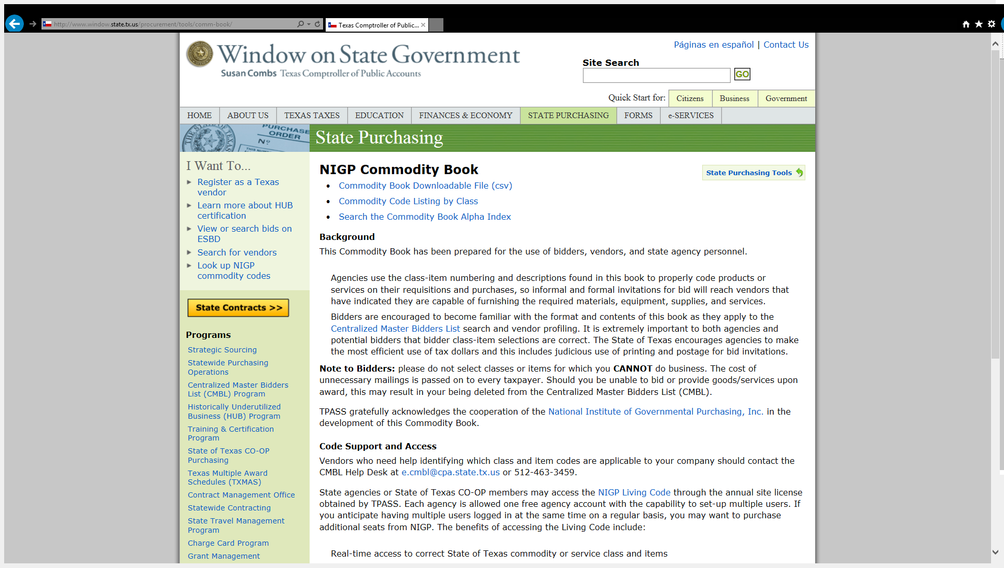

Slide 12
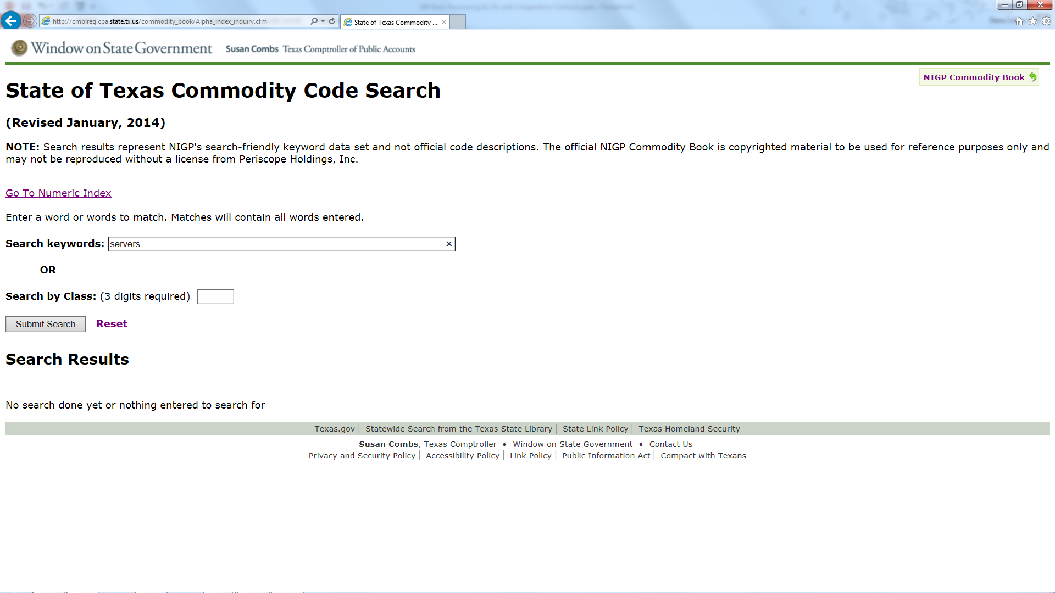

Slide 13
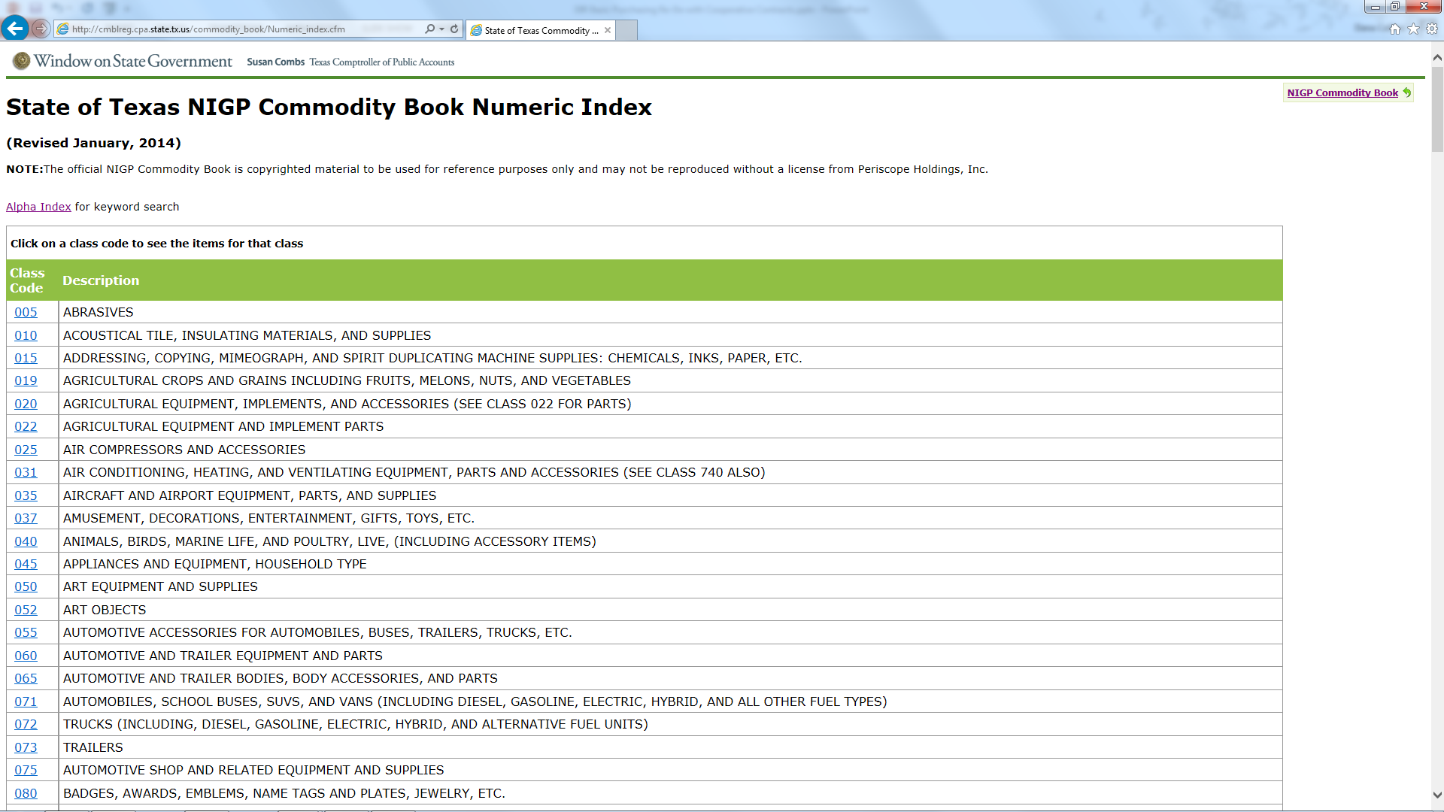

Slide 14
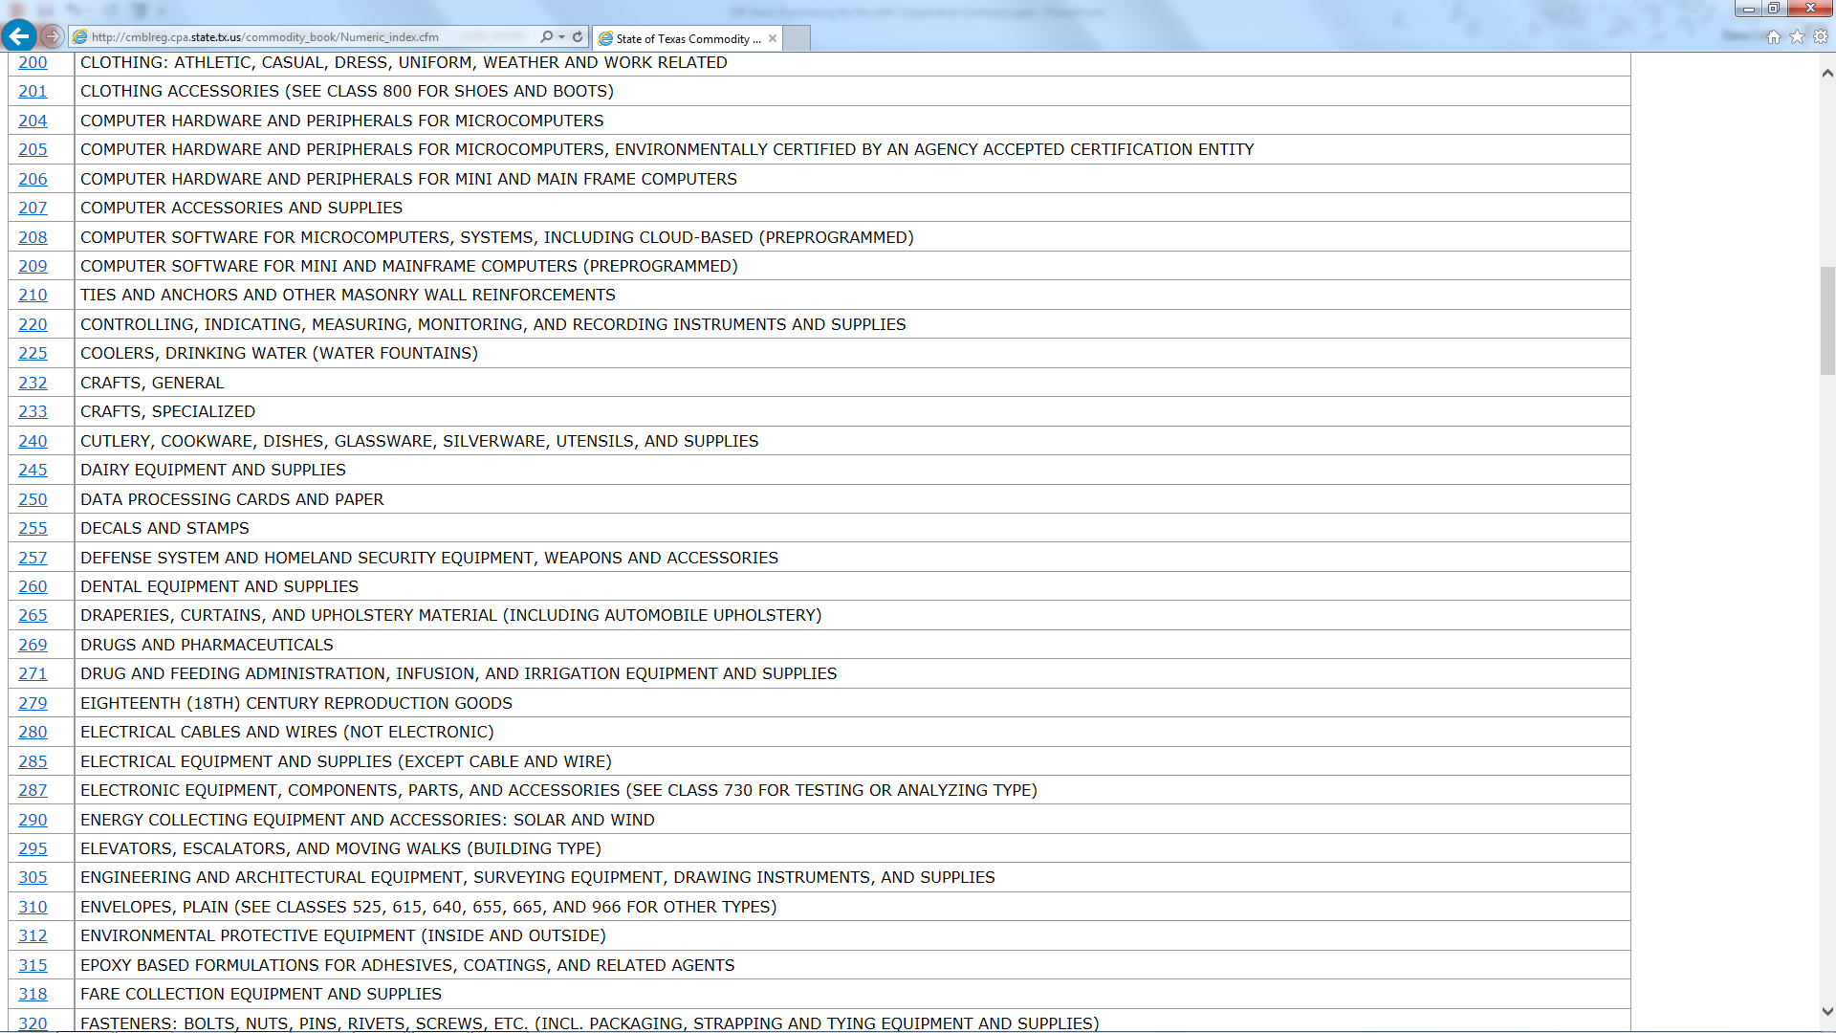

Slide 15
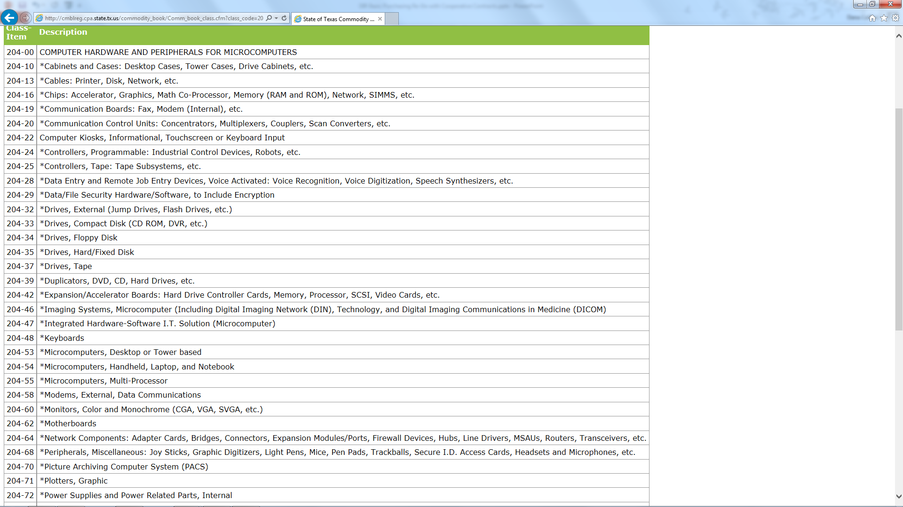

Slide 16
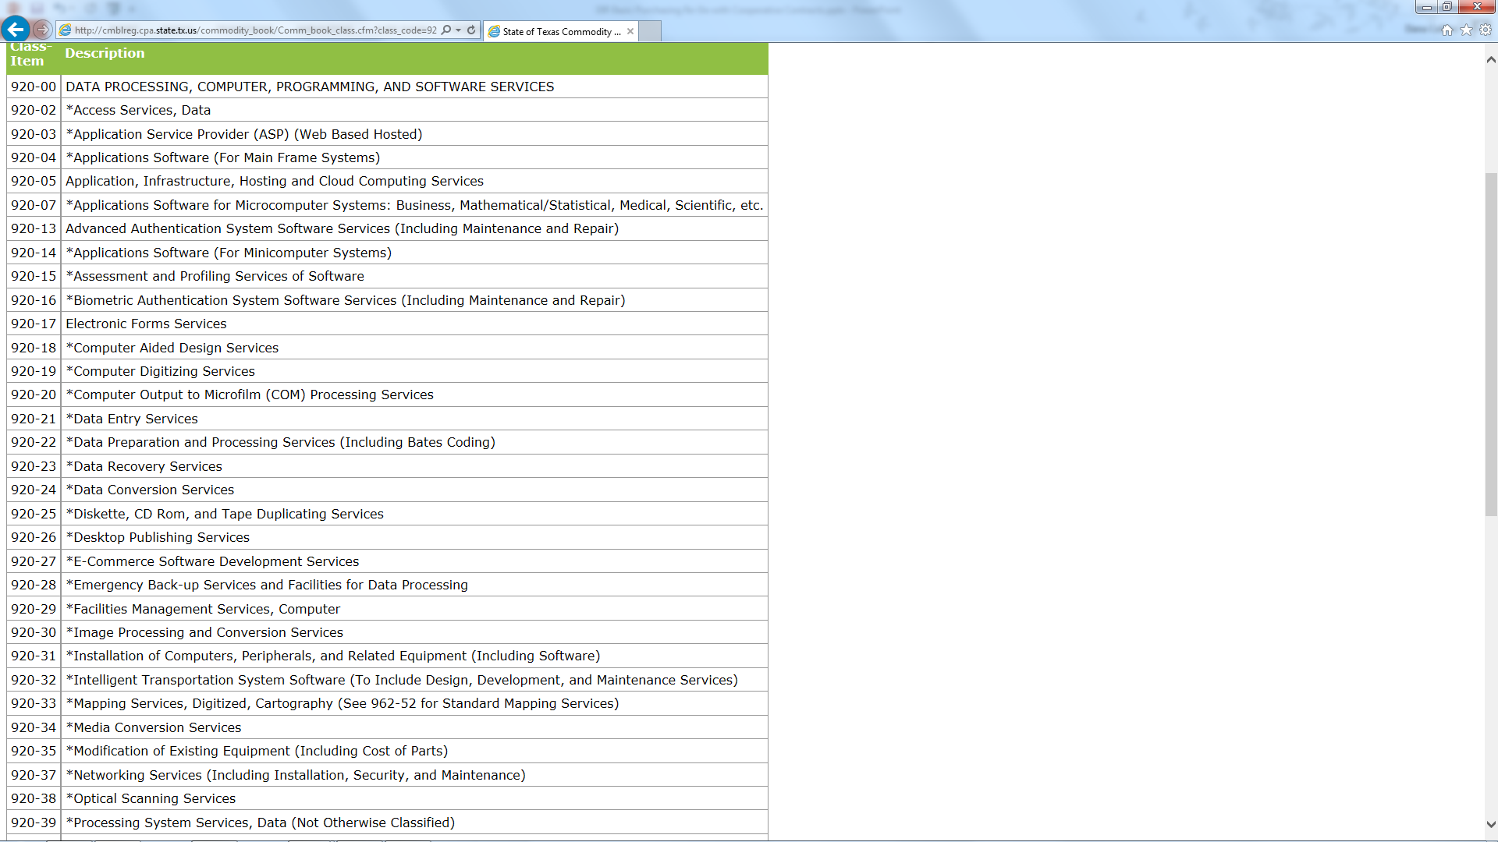

Slide 17
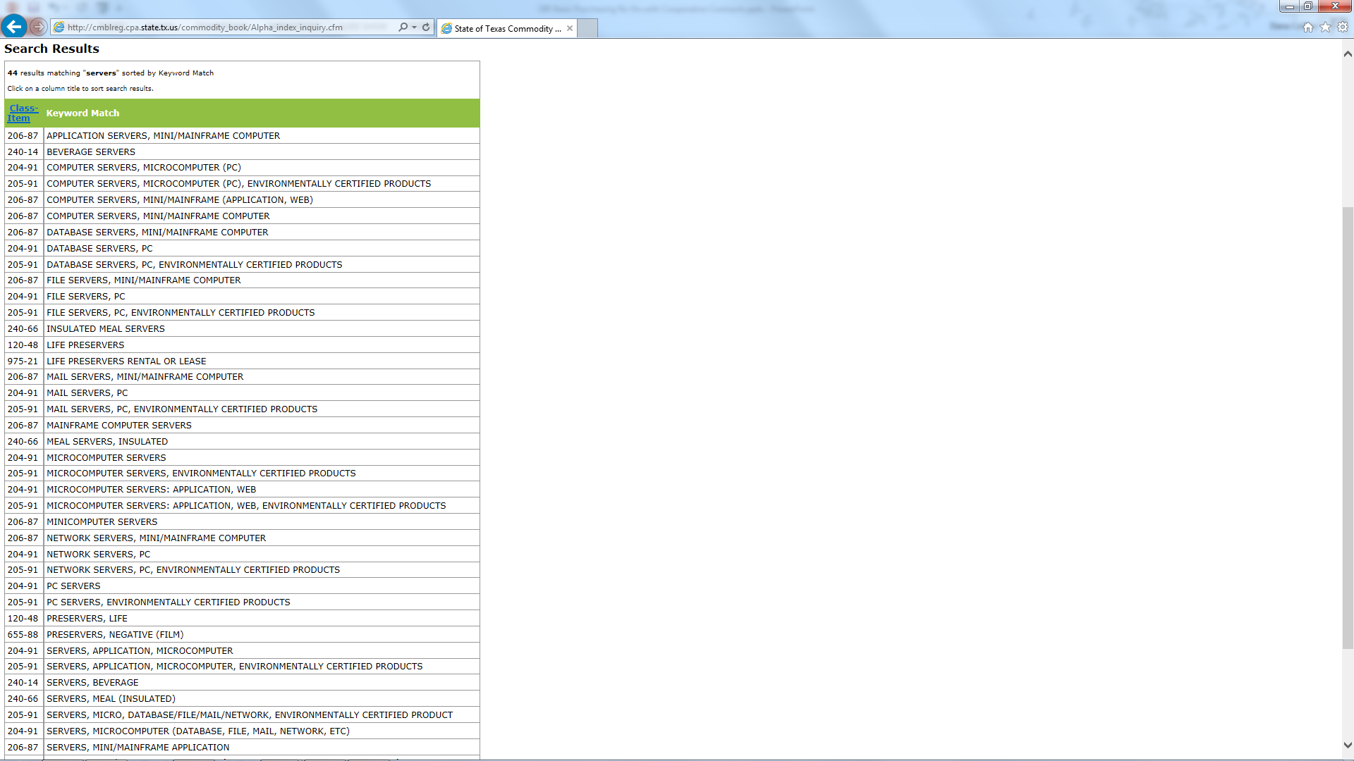
NOTE:
Searches using the alpha index search do not show the AIS asterisk indicator

Slide 18
Navigating DIR Website
*

Slide 19
Current Contracting Initiatives
Future Contracting Opportunities
Posted on DIR’s website under Information for Vendors
Lists initiatives by procurement stage
 Planning
 RFO Postings – links directly to the posting on the Electronic State Business Daily (ESBD)
 Evaluation
 Negotiation
 Recent Awards
Each initiative has a brief description, expected phase completion date, and contact information

Slide 20
Thresholds
Threshold | Number of Price Quotes Required
$50,000 or fewer | May directly award contract to DIR Cooperative Contracts vendor(s) or reseller(s)
$50,000 to $150,000 | Must submit request for pricing to at least three (3) DIR vendors or resellers
$150,000 to $1 million | Must submit request for pricing to at least six (6) DIR vendors or resellers
Exceeds $1 million? | May not enter into a contract through the DIR cooperative contracts program to purchase a commodity item
Notes:
The SB threshold requirement operationalizes what many agencies were are already doing. Going out to multiple vendors within the commodity category of the goods/services they are needing to procure.

Slide 21
Customer Exceptions
Threshold and Statement of Work review and signature processes do not apply
Institutions of higher education
K-12
Local governments
Assistance organizations
Out-of-state customers

Slide 22
Statements of Work
Statement of Work Required > $50,000 (including but not limited to):
  Cloud Services (if the customer completes a SOW)
  Deliverables Based Information Technology Services (DBITS)
  Managed Services for Information Technology
  IT Security Services
  Comprehensive Web Development

Slide 23
Statement of Work Review NOT Required
REVIEW
REQUIRED
  IT Staffing Services
  Support Agreements
  Maintenance Agreements
  Hardware or Software Only Contracts
Notes:
SB 20 does not require state agencies to obtain DIR’s signature on a resulting Purchase Order when using an IT Staffing Services contract. For the best value process, the SB 20 threshold requirements apply to IT Staffing Services contracts; however, state agencies are still required to obtain a quote from two ITSAC vendors (including one quote from the Texas Industries for the Blind and Handicapped) to fulfill the $50,000 or less requirement. For the ITSAC competitive solicitation process, DIR will solicit responses from all ITSAC vendors for a selected labor category. This process will ensure that state agencies will have met all pricing request threshold requirements of SB 20.

Slide 24
Program Exemptions
Threshold requirements and Statement of Work processes do not apply to contracts procured through the Data Center Services program signed by the contracted vendors (e.g. Atos, Capgemini and Xerox Corporation).
All SOWs that are being administered through the DCS program as a pass-through expense are subject to SB 20 and state procurement rules. The SOW draft will need to be sent to DIR for review and the final SOW will require DIR’s signed approval.

Slide 25
Program Exemptions
Thresholds do not apply to contracts for telecommunications services, such as TEX-AN Services and Managed Services for Telecommunications.
Managed Services for Telecommunications contracts have separate review process for approval of Statements of Work, but will not require DIR signature for executing the SOW.

Slide 26

DIR Review of SOWs
DIR will be reviewing your SOW to ensure the scope is appropriate for the DIR contract(s) selected. What does that mean?
Notes:
SB 20 now requires a two-step process that includes an initial SOW review by DIR and then a final DIR signature.

Slide 27
Draft SOW Submission
1: Agency Submits Draft SOW to DIR
2: DIR Reviews and Consults with Agency
3: DIR Responds to Agency within 30 working days of submission
4: Agency submits Approved SOW to relevant DIR vendor(s)

Slide 28
Draft SOW Submission
1: Agency evaluates vendor responses and negotiates final version of SOW
2: Agency and vendor execute final version of SOW
3: Agency sends final signed SOW to DIR for approval
4: DIR reviews, approves, signs and returns SOW to agency.
Agency issues the purchase order to selected vendor.

Slide 29

IMPORTANT
  Agencies must post all executed SOWs on their websites
  Vendor can not be paid until DIR signs the final SOW

Slide 30
Approval Criteria
Contract meets SOW scope
Number of contracts matches threshold requirements
SOW is for services

Slide 31
Questions and Answers
Thank you
Dana L. Collins, CTPM, CTCM
Phone: 512.936.2233
dana.collins@dir.texas.gov

