Slide 1
Electronic State Business Daily (ESBD)
Cody Hays
Team Lead, Outreach
Notes:
Email/ number?

Slide 5
txsmartbuy.com

Slide 8
Notes:
Click Solicitation button to post an award associated with a solicitation.
Click Post/View/Awards to post an award NOT associated with a solicitation

Slide 9
Notes:
if false info is entered, the posting info will be audited and your solicitation will pulled down

Slide 13
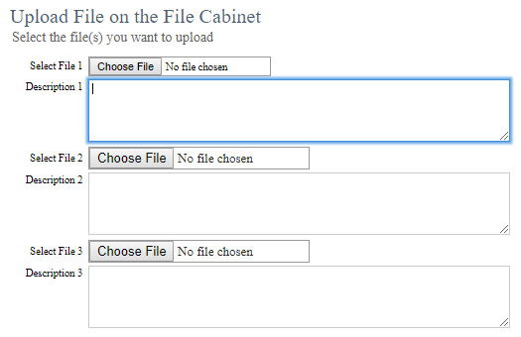

Slide 16
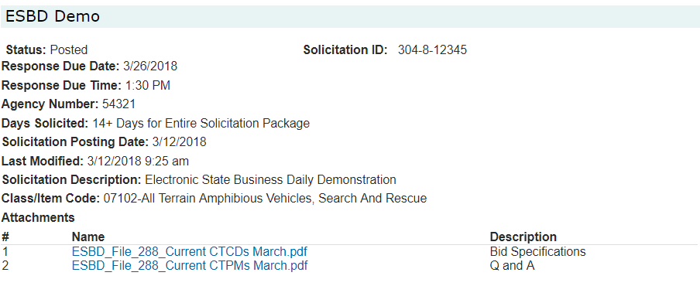

Slide 17
Contract Advisory Team-Review and Delegation (CAT-RAD)
Notes:
if you know you need to send your solicitation to CAT-RAD, you can go directly to the CAT-RAD app. If you are unsure, you can go through the ESBD application, start here and answer the preliminary questions.

Slide 19
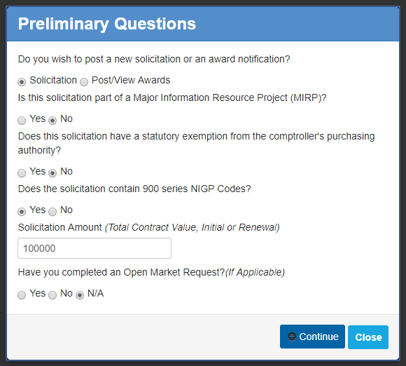

Slide 24
Notes:
Finally, you get to review all your info that was entered. Click Submit. Or click Previous to go back and modify

Slide 27
Automated emails after submission
Solicitation has been received
Solicitation has been assigned
Solicitation has recommendations
Complete

Slide 28
Questions/Comments?
Cody.Hays@cpa.texas.gov
512-463-3392
Notes:
Give outreach mailbox? Main line/vpts mailbox?

