Slide 1
Legacy Systems Study (LSS)
Analysis Briefing and Workshop

Slide 2
DIR Welcome
Todd Kimbriel
Chief Operations Officer
Priscilla Pipho
Chief Customer Officer

Slide 3
Agenda
DIR Welcome
  Todd Kimbriel, Chief Operating Officer and Priscilla Pipho, Chief Customer Officer
Meeting Process Overview
  Lynda Baker, Strategic Communications Facilitator
Legacy Systems Study Context
  John Van Hoorn, Director, DIR Enterprise Solution Services
Briefing
  Ernst Rampen, Director, Gartner Consulting
  Justin Gaspard, Director, Gartner Consulting
Break
Work Sessions
Next Steps
DIR thanks the Texas Association of State Systems for Computing and Communications (TASSCC) for sponsoring this program.
2

Slide 4
Ideas for:
Remediation
Collaboration
Application Portfolio Management
Any Question

Slide 5
Legacy System Study - Background
HB 2738 – legislation requiring DIR to conduct a legacy study
Inventory systems maintained by state agencies
Identify costs, security risks and, if feasible, remediation estimates for legacy systems
Provide a plan for assessing and prioritizing statewide modernization projects

Slide 6
Legacy System Study - Timeline
September 2013 – Began inventory
May – June 2014 – Completed inventories
June – July 2014 – Began data analysis and application assessments
August – September 2014 – Analysis and recommendations report creation
October 2014 – Presentation to state leadership

Slide 7
Legacy System Study - Deliverable
Analysis data and recommendations
  To state agencies
  To state leadership upon request
  Data classified as confidential
Executive Summary
  To State Leadership
  Summary is publicly available

Slide 8
Briefing Content
Legacy System Study Analysis Methodology
  Review of the process to identify business applications’ technology components
  Determining the legacy status of hardware and software
  Developing remediation options
Characteristics of the Texas agency technology landscape
  Application types, infrastructure and tool types
  Potential areas to leverage shared solutions
Industry technology trends
  Cloud: Software-as-a-Service and Platform-as-a-Service
  Customer self-service
  Mobility
  Citizen development

Slide 9
Legacy System Study Analysis Methodology

Slide 10
Legacy System Study Analysis Methodology
Overview: Where Are We Now?
1
2
Collect Application and Technology Components Data
Determine Support Status of Technology Components
Agencies determine legacy status
DIR and Gartner determine legacy status
3
4
Agencies provide application characteristics
Conduct Legacy Application Assessment
Perform Analysis and Categorization
DIR and Gartner conduct analysis
5
Agencies provide input in workshops
Develop Recommendations
  DIR and Garter develop cost, security risks, update feasibility, modernization and consolidation opportunities

Slide 11
Legacy System Study Analysis Methodology
Poll Everywhere Question
Agencies were given an option to provide a legacy status of business applications, when this data was first collected.
What was the predominant reason your agency qualified system components as legacy?
Obsolete technology
Difficult or expensive to support
Lack of agility to adopt to new requirements
Functionality no longer matches business need
Other
Don’t know

Slide 12
What was the predominant reason your agency qualified system components as legacy?

Slide 13
Legacy System Study Analysis Methodology
Determining Legacy Status of the “Stack”
Business Application
Enabling Software
Supporting Software
Legacy driver: Vendor support status
Initial data gathered by DIR
Legacy driver: Gartner Market Clock
Operating Environment (Operating System, Virtualization)
Legacy driver: Gartner Market Clock
Server Technology (Hardware)
Business applications are dependent on a number of technology components
  Enabling software; application server and databases
  Supporting software; backup/restore and monitoring
  Operating environments; operating systems and virtualization
  Server technology; the hardware platform
Each of these components may be in a different phase of its lifecycle
  We review these components to determine the legacy status of a business application

Slide 14
Legacy System Study Analysis Methodology
3rd party Software Support Lifecycle
Software product deemed Legacy
Active Support
Extended Support
No Support
Product Release
End-of-Life
End-of-Support
End of
Extended Support
Time
This timeline shows the typical software support lifecycle. Not all software vendors distinguish between these milestones

Slide 15
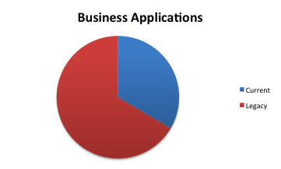
Legacy System Study Analysis Methodology
Accumulated Software Components
To date, agencies have provided data for 4,460 applications
These applications are implemented with approx. 112K software components
Based on the support status of the technology, approx. a third of the business applications are current, while two thirds have enabling components that are out of active support

Slide 16
Legacy System Study Analysis Methodology
Poll Everywhere Question
For a variety of reasons, organizations retain technology beyond their standard or extended support windows. When managed well, the risks of reliance on outdated technology may be reduced.
How does your agency manage its application portfolio with respect to technology lifecycle support and risk mitigation?
No active portfolio management
Focus on critical business applications only
Informal portfolio management with awareness of technology support windows
Formal portfolio management with active technology lifecycle management
Other
Don’t know

Slide 17
How does your agency manage its application portfolio with respect to technology lifecycle support and risk mitigation?

Slide 18
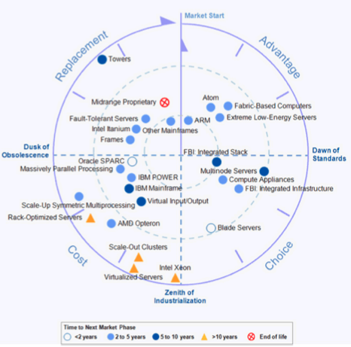
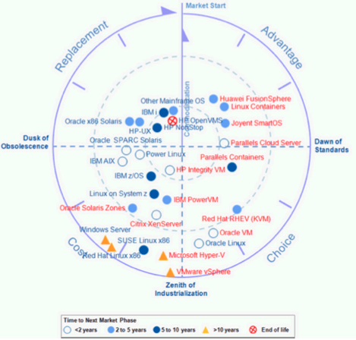
Legacy System Study Analysis Methodology
Determination of Hardware Viability
IT Market Clock for Server Technology
The software that supports agency business application runs on:
  Server technology, or the hardware platform
  Operating environment, or the operating system and possibly virtualization
The lifecycle stage of these technologies is tracked by Gartner in IT Market Clocks*
  Advantage (12-3 o’clock)
  Choice: (3-6 o’clock)
  Cost Optimized (6-9 o’clock)
  Replacement (9-12 o’clock)
We consider the technology to be legacy when it is in the replacement zone
IT Market Clock for Server Virtualization
And Operating Environments
* See appendix for details

Slide 19
Legacy System Study Analysis Methodology
Determination of Hardware Viability – Technology Categorization
Server technologies used by agency business systems:
  Commodity hardware, such as rack-mounted X86 servers, or aging towers
  Current RISC environments, such as POWER and SPARC
  Mainframe environment
  To be discontinued technology, such as Itanium, or already discontinued midrange proprietary architectures, such as PA-RISC and RS/6000
Operating environments:
  Discontinued OSs such as Windows NT/2000/2003 and Netware
  Aging OSs that become less viable, such as HP/UX and z/VSE
  Modern Windows OSs, such as 2008 and 2012
  Viable UNIX variants, such as AIX and Solaris
Server Technology
Operating Environment
Old Windows
(NT, 2000)
✗
X86 Blades,
Servers
Modern Windows
✔
Netware
✗
POWER
AIX
SPARC
Solaris
Hardware
List
✔
Mainframe
z/OS
z/VSE
✗
Itanium
HP/UX
✗
Midrange Proprietary
✗
✔
Towers
✗
Viable
Legacy
✗

Slide 20
Legacy System Study Analysis Methodology
Poll Everywhere Question
Organizations face many challenges in keeping technology components current, ranging from funding to complexity of dependencies.
What is the primary inhibitor to maintaining technology current in your agency?
Ongoing funding after initial investment in solution
Resource availability for regression testing
Dependencies within the application or infrastructure architecture prevent updates
Difficulty “selling” technology updates without significant functional benefits
Other
Don’t know

Slide 21
What is the primary inhibitor to maintaining technology current in your agency?

Slide 22
Legacy System Study Analysis Methodology
Obtaining Business Value and Application Characteristics
Individual application legacy drivers guide remediation options
Remediation drivers: Business Value, Cost, Risk and Application Type
Business Application
Gathered through online assessment
Enabling Software (Programming Language, Middleware, Database, etc.)
Supporting Software
(Backup, Security, Tools, etc.)
Legacy driver: Vendor support status
Gathered through spreadsheets
To be augmented through survey
Operating Environment (Operating System, Virtualization)
Legacy driver: Gartner Market Clock
Server Technology (Hardware)
Legacy driver: Gartner Market Clock
Business value, technical condition and cost drive prioritization within the portfolio

Slide 23
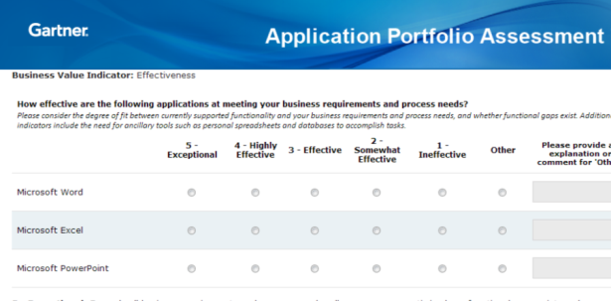
Legacy System Study Analysis Methodology
Legacy Application Categorization and Remediation Options
  Online tools are currently collecting data from hundreds of people across hundreds of applications over the past two months
Analysis will then contrast business, technology, cost indicators through various pace layer and overhaul filters to find signatures/fingerprints of legacy software
The resulting comparative prioritization will help to identify application remediation activities according to tolerate, invest, migrate, and eliminate (TIME)
High
TIME
Business Value
Tolerate
(Reevaluate /
Reposition Asset)
Innovate / Invest (Maintain / Evolve Asset)
Technical Effectiveness
Eliminate
(Retire / Consolidate Asset)
Migrate
(Reengineer / Modernize Asset)
Analysis Perspectives
Technical Effectiveness
Cost
Low
High
Business Value
Cost / Risk
High
  Online tools are currently collecting data from hundreds of people across hundreds of applications over the past two months

Slide 24

Legacy System Study Analysis Methodology
Legacy Application Categorization and Remediation Options
Software
Business App
Legacy Status
Hardware Platform
Business Value
Cost
Technical Effectiveness
Criticality
Utilization
Effective ness
…
Support
Development
Licensing
…
Extensibility
Programming Language
Standards
Risk Profile
Decision Framework
Eliminate/Tolerate
Innovate/Invest
Migrate
Eliminate / Retire
Tolerate
(no change)
Replatform Hardware
Upgrade Software Stack
Upgrade COTS
Transform Code
Consolidate
Replace with COTS
Rewrite

Slide 25
Legacy System Study Analysis Methodology
Remediation Options – Tolerate and Eliminate
Remediation Option | Description | Possible Fit For
Eliminate/Retire | Retire the business application, using functionality of other applications to perform the business function | Legacy applications that are low value, providing functionality that can be supported by other applications in the current portfolio Example: secondary financial systems that track expenditures that can be managed within the statewide financial system
Tolerate/No Change | Leave the business application as-is | Legacy applications that are high value, low cost, have a low degree of change and are relatively low risk Example: staff-facing asset management applications that run on older technology

Slide 26
Legacy System Study Analysis Methodology
Remediation Options – Invest/Innovate
Remediation Option | Description | Possible Fit For
Replatform Hardware | Move the business application to a new server technology | Legacy applications that are high value and have a sound software technology foundation, but run on aging hardware that can be replaced without significant impact to the business application Example: licensing systems that use modern application servers on aging servers that can be ported to modern hardware
Upgrade Software Stack | Upgrade underlying enabling software (application servers, databases, etc.) to current versions | Legacy applications that are high value and have a sound architecture, but run on outdated software with manageable impact to the business application Example: permitting systems that use older versions of .NET environments or SQL Server databases that is superseded by modern versions
Upgrade COTS | Upgrade the Commercial Off-the-Shelf (COTS) software, that implements the business application, to a current version | Legacy applications that are high value and are implemented with a viable COTS solution, but runs on an old version of the COTS solution that can be upgraded with a manageable impact to the business application Example: human resource systems that use older versions of an ERP solution that is superseded by modern versions
Transform Code | Transform the application code of a custom application from a legacy programming language/platform to a current platform, without making significant functional changes | Legacy applications that are high value and generally meet the current and anticipated business needs, but have been built with a programming language or platform that can no longer maintained by readily available resources in the marketplace Example: registration applications that run on COBOL and non-relational databases

Slide 27
Legacy System Study Analysis Methodology
Remediation Options - Migrate
Remediation Option | Description | Possible Fit For
Consolidate | Combine the functionality of a legacy application with another existing application | Legacy applications that provide important functionality that is similar to functionality provided by another existing system, which could feasibly incorporate this functionality Examples: Provider management system that tracks vocational schools, which is similar to tracking adult education providers Agency financial systems that are similar to financial systems for other agencies
Replace with COTS (Software as a Service or on-premise) | Replace a custom or aging Commercial Off-the-Shelf (COTS) system with a modern COTS solution | Legacy applications that support important business functions, but are implemented with aging custom developed software or obsolete COTS software that cannot be readily upgraded, but is readily supported with modern COTS solutions Examples: Custom developed case management system that has a good functional fit with COTS case management solutions Aging Telligent content management system that no longer has an upgrade path
Rewrite | Replace the business application with a new custom developed solution | Legacy applications that that support business critical functionality, but can cannot be remediated with any other option Example: business application that supports unique Texas capability

Slide 28
Legacy System Study Analysis Methodology
Poll Everywhere Question
When considering remediation, an option is to collaborate between agencies to cover business needs of multiple agencies with a single solution. Common needs between agencies range from communication/productivity (email, calendaring, etc.) to business functionality (case management, customer self-service, etc.)
We will seek further input in the work session.
Would your agency consider such an approach?
No, our needs are too specific
Yes, but only for “low hanging fruit” such as email
Yes, but only if our agency has significant interaction with another agency
Yes, we are open to exploring pragmatic and cost-effective solutions
Maybe

Slide 29
Would your agency consider such an approach?

Slide 30
Legacy System Study Analysis Methodology
Next Steps

Slide 31
Characteristics of the Texas agency technology landscape

Slide 32
Characteristics of the Texas Agency Technology Landscape
Vendor Landscape
Much of the technology landscape is split between:
  Microsoft-centric technology
    Servers
    Application/database software and tools
  IBM-centric technology
    Mainframe
    Distributed systems
    Application/database software and tools
  Oracle-centric technology
    Application/database software
A diverse landscape of vendors and products
  ~500 vendors overall
  ~50% have only 1 or 2 products in use by TX agencies

Slide 33
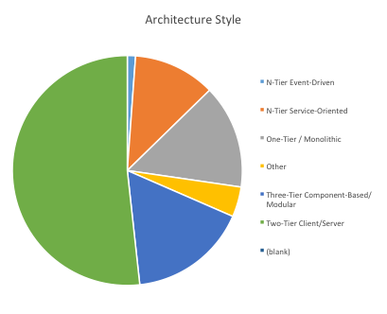
Characteristics of the Texas Agency Technology Landscape
Technology Architecture Style
Based on a preliminary subset of agency business application assessment data, the predominant architecture style is traditional client/server
  This includes both custom developed and package-based applications
  These are typically not web-based applications

Slide 34
Characteristics of the Texas Agency Technology Landscape
Application Pace Layers
Based on a preliminary subset of agency business application assessment data, ~95% of applications fall in the Systems of Record and Systems of Uniqueness layer
  Many applications have long lifecycles and a slow rate of change
  About half of the business applications maintain master data
Systems of Uniqueness
Systems of Uniqueness

Slide 35
Characteristics of the Texas Agency Technology Landscape
Poll Everywhere Question
Some of the preliminary data indicates a significant amount of traditional client/server applications, a high degree of unsupported software components, a fragmented technology landscape and supporting System of Record type business applications.
Many business applications likely were developed as point solutions, and became a part of the core application portfolio. There is likely an opportunity to, at a minimum, standardize and streamline the technologies.
What is your agency’s technology direction for applications that will likely become a system of record?
We standardize on certain “big” vendors where possible (Microsoft, IBM, Oracle, etc.)
We select best-of-breed solutions but standardize the underlying technology
We select optimal business solutions, regardless of the technology
We determine the technology on a case-by-case basis
Other
Don’t know

Slide 36
What is your agency's technology direction for applications that will likely become a system of record?

Slide 37
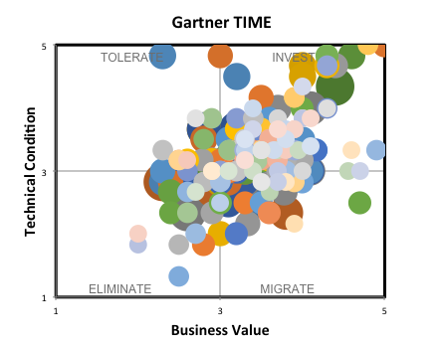
Characteristics of the Texas Agency Technology Landscape
Application Characteristics in TIME Framework
Based on a preliminary subset of agency business application assessment data, many applications may be candidates for continued use by investing in:
  Replatforming onto modern hardware
  Upgrading software components that support the application
  Updating the version of the package-based solution
  Transform code to a modern and sustainable environment

Slide 38
Characteristics of the Texas Agency Technology Landscape
Preliminary Insights
10% of applications are identified as duplicate
25% of applications have one or more identified security risk; some applications have 3+ risks
50% of applications have no planned maintenance investment (no remediation costs)
80% of applications require specialized skills
80% of applications are departmental only
There is a strong correlation between new applications and overall perceived value.

Slide 39
Industry technology trends

Slide 40
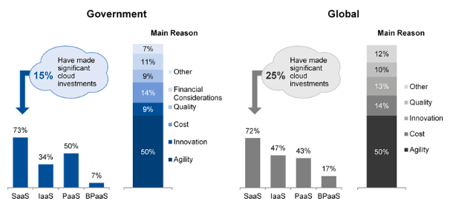
Industry technology trends
Cloud: Leveraging Software, Platform and Infrastructure Services
Compared to overall trends in government priorities, Texas is placing an even higher emphasis on cloud adoption
Adoption of public cloud by most government agencies is running 10% and three years behind that of the global view
  Heightened concerns among government agencies about security, privacy and requirements to keep data within a jurisdiction serve as a drag to public cloud adoption
A large portfolio of legacy applications impedes cloud adoption
  Applications on aging infrastructure cannot leverage Infrastructure-as-a-Service (IaaS)
  Applications using aging software components cannot leverage Platform-as-a-Service (PaaS)
  Packaged applications using aging products cannot leverage shared/hosted versions of those products through Software-as-a-Service (SaaS)
Texas Priorities | Overall Government Prio.
Security and Privacy | Infrastructure and Data Center
Cloud | BI/Analysis
Legacy Modernization | Mobile
Virtualization | Cloud
Business Continuity | ERP
Enterprise Planning / Collaboration | Security
IT Workforce | Networking, Voice and Data
Data Management | Legacy Modernization
Mobility | Digitization
Network | Industry-Specific Apps
Technology Focus: Texas (DIR, 2014) and Government (Gartner, Match 2014)
Attitudes Toward Public Cloud: Government vs. Global (Gartner, Match 2014)

Slide 41
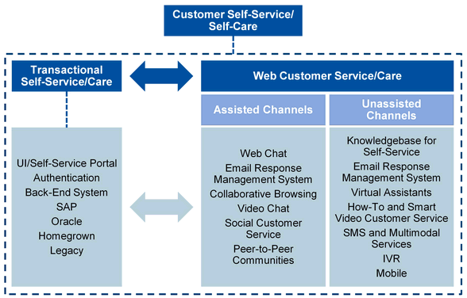
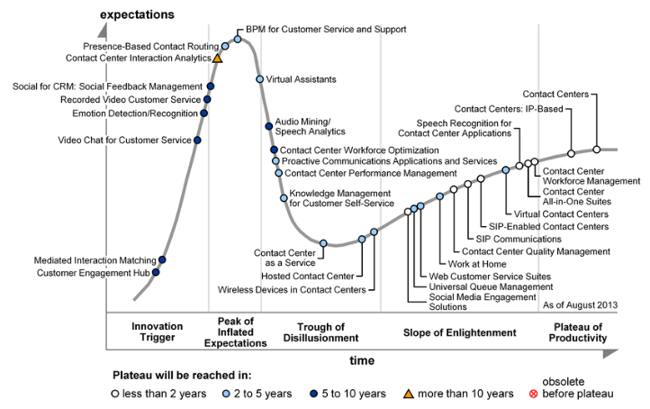
Industry technology trends
Online, Customer Self-Service to the Public
State and local government agencies continue to invest in web-based customer self-service
  Shifting low-value services from case workers to leverage skills on more critical tasks
  Providing 24/7 access to frequently used services
  Adapting to expectations of the public, influenced by continuous consumerization and the digital enterprise
Online, self-service capabilities are rapidly becoming available through vendors of different backgrounds
  Contact centers, portals, collaboration
A large portfolio of legacy applications impedes customer self-service programs
  Poor interfacing options for real-time data exchange
  Application and data “silos” are common
  Lack of agility prevents timely adaption to needs
  Maintenance windows prevent 24/7 access
Transactional Self-Service Versus Web Customer Service Gartner, 2013)
Hype Cycle for Contact Center Infrastructure (Gartner, August 2013)
See appendix for larger graphic

Slide 42
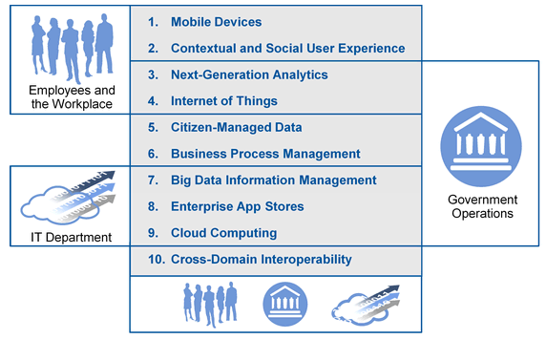
Industry technology trends
Mobility
As smartphones and media tablets continue to gain market share relative to PCs, location-aware mobile devices are now pervasive throughout government agencies
  The challenges currently posed by mobile devices in government make them unlikely replacements for PCs. Thus, they will remain additive devices in the short run
  Many package-based solutions include mobile companion-applications with pre-configured integration
A large portfolio of legacy applications impedes taking advantage of mobile capabilities
  Poor interfacing options for real-time data exchange
  Mismatch between security implementations
  Lack of agility prevents timely adaption to needs on the “back end”
Top 10 Strategic Technology Trends for Smart Government (Gartner, Match 2013)

Slide 43
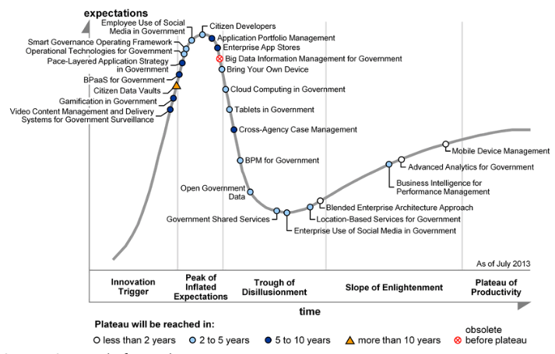
Industry technology trends
Citizen Development
There is always more demand for solutions than IT resources can provide
In many cases, business users develop their own applications using unsupported tools
  The technology is typically not managed
  The solutions often result in duplicate data entry, data inconsistency and exposure to data loss
A Citizen Development program and technology allows business user application development with IT's blessing and support
  IT provisions rapid development tools (either brokered as a cloud solution or on-premises); these tools are easy to use
  IT provides data integration to system of record data in a secure and controlled fashion
  IT administrators provide basic security, back up, reliability, performance, etc. for the applications
A well planned Citizen Development implementation can be a remediation for legacy point solutions
Development Style vs. Pace Layers (Gartner, 2013)
Hype Cycle for Smart Government(Gartner, July 2013)
See appendix for larger graphic

Slide 44
Break
Be back in 10 minutes

Slide 45
Work Sessions

Slide 46
Appendix

Slide 47
Appendix
IT Market Clock for Server Technology, 2013

Slide 48
Appendix
IT Market Clock for Server Virtualization and Operating Environments, 2013

Slide 49
Appendix
Hype Cycle for Contact Center Infrastructure (Gartner, August 2013)

Slide 50
Appendix
Hype Cycle for Smart Government (Gartner, July 2013)

Slide 51
Wrap-up

Slide 52
Contacts
DIR
LSS Team Lead
John Van Hoorn
Director
DIR
Telephone: 512 463 9351
John.Vanhoorn@dir.texas.gov
LSS Coordinator
Allan Martin
Director
DIR
Telephone: 512 463 5973
Allan.Martin@dir.texas.gov
LSS Coordinator
Mike Tyler
Analyst
DIR
Telephone: 512 463 7082
Mike.Tyler@dir.texas.gov
Session Facilitator
Lynda Baker
Strategic Communications Facilitator
DIR
Telephone: 512 463 2362
Lynda.Baker@dir.texas.gov
Project Manager
Kevin McCabe
Project Manager
DIR
Telephone: 512 463 5644
Kevin.Mccabe@dir.texas.gov

