Slide 1
Writing an Effective Statement of Work Parts 1 & 2
DIR Connect
May 25, 2016
Notes:
Module Title: DBITS Contract Utilization and Management

Slide 2
DIR Conference Speakers
Shannon Kelley
Manager Enterprise Contract Management
Elizabeth Lopez
Contract Manager Enterprise Contract Management

Slide 3
AGENDA
Statement of Work
Standard elements of an SOW
SOW Lifecycle
Plan the SOW
Building the SOW
Other Planning Considerations
Select the Vendor
Best Practices for using DIR contracts
Manage the SOW
Managing the SOW
Dealing with Changes
Issues & Disputes

Slide 4
STATEMENT OF WORK
Standard Elements of an SOW

Slide 5
Statement of Work Defined
A Statement of Work (SOW) is a formal document that captures and defines the work that must be performed to meet a Customer’s needs
Not only does a SOW provide a commitment for all parties involved in a project, it forms the basic framework of a Contract
SB 20, Sec. 2157.0685
"statement of work" means a document that states the requirements for a contract, including deliverables, performance specifications, and other requirements, specific to the vendor under that contract …

Slide 6
DIR Contract Categories Appropriate for SOWS
DIR has established contracts that prequalify vendors to respond to SOWs across a variety of technology categories, including:
Deliverables Based Information Technology Services (DBITS)
Managed Services for Information Technology
Comprehensive Web Development
IT Security Services
Cloud Services

Slide 7
SOW Elements
While a Statement of Work is unique for each project, SOW elements are generally consistent across projects:
Scope of Project
Roles and Responsibilities
Deliverables
Schedule
Performance and Service Levels
Acceptance Criteria
Pricing and Payment Schedules/Milestones
Assumptions

Slide 8
SOW Elements
Additional Considerations:
Submission/Format
Reports and Meetings
Period of Performance
Customer Furnished Equipment and Workspace
Additional Terms and Conditions
Notes:
Minimum suggested items in the Statement of Work template include:
Scope of work
Project risks, assumptions and constraints
Roles and responsibilities
Detailed description of deliverables
Acceptance criteria, including testing or period of review
Project completion criteria
Project schedules to be achieved by vendor
Relevant quality processes

Slide 9
SOW Lifecycle
This training establishes best practices in the Statement of Work lifecycle:
The planning responsibilities to begin with the right foundation
The intended selection approach to be leveraged by agencies
The best practices in vendor management to agreed outcomes

Slide 10
SOW Lifecycle
PLAN
○Define need
○Assess project risk
○Develop SOW elements
necessary to manage
the contract
SELECT
○Submit SOW to
appropriate categories
○Review responses
○Initiate work with the
selected vendor
MANAGE
○Develop tools necessary
to manage the vendor
○Document vendor
performance

Slide 11
PLAN
Building the Statement of Work
Notes:
Section Title: Plan | Building a Statement of Work

Slide 12
Project Scope
In developing the project scope, key questions to ask are:
Who needs to be on the team to make this succeed?
Can we scope something we can manage?
Can we identify risks in order to mitigate them?
Can we build elements into the SOW to help us manage?

Slide 13
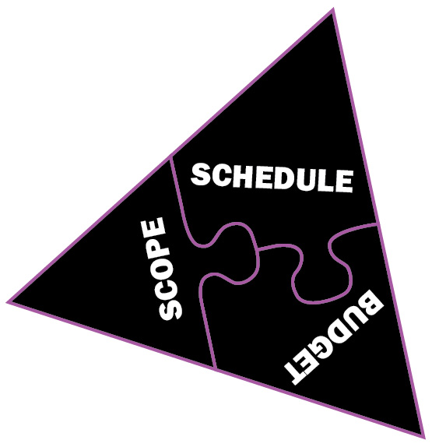
The Iron Triangle (and when it’s not iron)
Traditional Statements of Work are legally enforceable agreements to transact business in a combination of scope, schedule and budget
A clear scope, schedule and budget are core to good planning and effective management of the
Statement of Work
Acceptance criteria is the glue that holds
it all together

Slide 14
Who Carries the Risk?

Slide 15
Brainstorming Project Goals and Objectives
Start by asking and answering basic questions:
What does COMPLETE look like and how will we
know we’re there?
How will we measure success?
What are the milestones that we will need to identify to measure progress?

Slide 16
Essentials of a SMART* Objective
SMART
To grow online registration by 5%, by fiscal year end
To reduce licensure wait time to less than 2 minutes, by the end of June
To double our capacity to deliver benefit disbursements by November 1
NOT SO (SMART)
Maximize potential of agency website traffic
Improved operational performance management through increased automation
Website optimization through user friendly interfaces
SMART* (Specific, Measurable, Achievable, Realistic, and Timely)

Slide 17
Getting to the Right Scope
Defining the project scope is a progressive elaboration of the requirements of the product(s) or service(s) that are needed to satisfy the project objectives
Working with stakeholders, the Project or Contract Manager should facilitate open dialogue to elicit the product or service requirements
This process should encourage discussion and seek clarification to ensure the project team fully understands the requirements
Through effective elicitation techniques, the team can develop a set of precise, accurate, and comprehensive requirements

Slide 18
Getting to the Right Scope (cont.)
The project scope should :
describe the outcomes, or deliverables, and NOT the tasks
specify requirements of project work products, such as the management plan, schedule, and milestones
More information and additional resources on requirements gathering is provided as a training handout

Slide 19
Example: From Goal to Objectives
A goal of the Texas Department of Government Records (TDGR) is to promote openness and accountability in state government
To meet this goal, TDGR has launched an IT transformation project. The project’s objectives are:
To develop and implement a statewide eDiscovery strategy by March 1, 2017,
To transition 25% of the state’s permanent records to an electronic format by Q3 FY 2017, and
To realign its technology workforce and processes to provide direct support to all state agencies by Q3 FY 2018

Slide 20
Example: From Objectives to Scope
To implement the objectives of this project, TDGR has engaged stakeholders
To advance its transformation effort, TDGR plans to assess its current technology organization
TDGR has determined that it will obtain the services of a DIR vendor, but first, TDGR will scope the project and define the project’s deliverables by developing a Work Breakdown Structure (WBS)

Slide 21
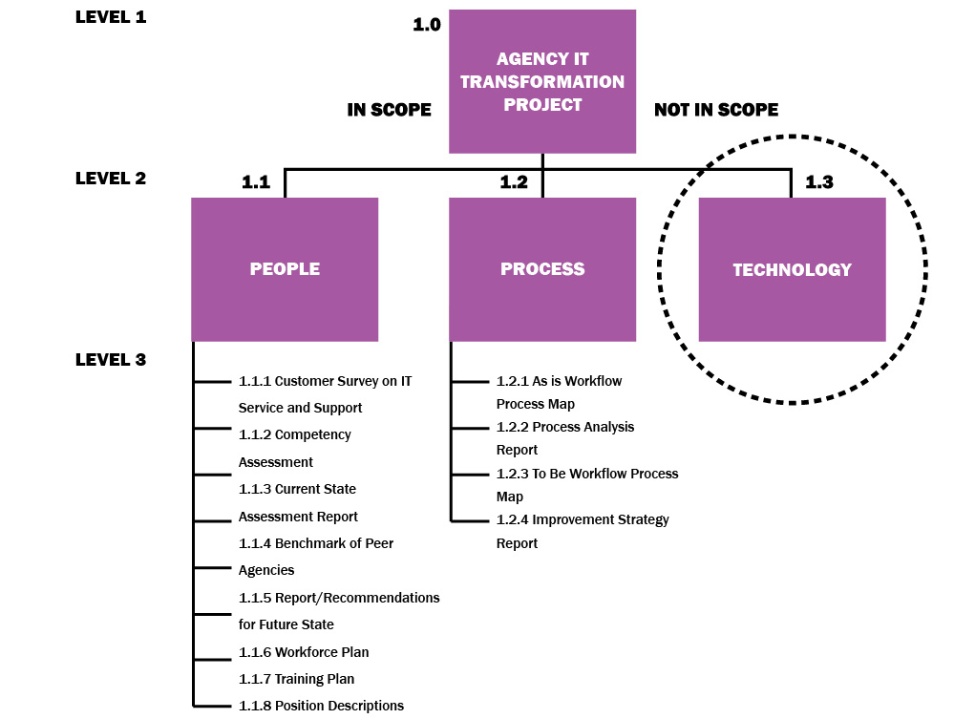
Example: From Scope to Deliverables
Create a deliverables oriented WBS
Identify what’s in scope and what’s not in scope
Identify the project deliverables
Establish a basis to create acceptance criteria, project milestones, and schedule

Slide 22
Example: From Scope to Deliverables

Slide 23
Example: From Deliverables to Acceptance
NO. | DELIVERABLE NAME | WBS# | DUE DATE | ACCEPTANCE CRITERIA
1 | Customer Survey on IT Services and Support | 1.1.1 | I week after project start date | 20-30 scaled questions reflecting performance attributes set forth in AMA Handbook for Customer Satisfaction
2 | Competency Assessment | 1.1.2 | As specified in Project Work Plan (see also 4.2.1 key Milestones Timeline) | Generic, Managerial and Technical Competency Mapping to Organizational Strategies, Mapping must provide detail at each level of Core, Business, Team and Role
3 | Current State Assessment Report | 1.1.3 | As specified in Project Work Plan (see also 4.2.1 Key Milestones Timeline) | - Identification of existing processes , desired outcomes, processes to achieve the desired outcomes - Identification and description of gaps - Description of means to fill gaps and requirements to bridge gaps

Slide 24
Writing an Effective Deliverable
A deliverable should:
be related to the project objectives
provide unambiguous and sufficient detail
describe a standard for performance
provide a means to trace and monitor requirements
be tied to a compensation structure that is consistent with the work performed

Slide 25
Roles and Responsibilities
Detail for both customer and vendor
Examples:
Customer Roles and Responsibilities
Site access at all three locations
Purchase and delivery of network equipment
Configuration design for all network equipment
Vendor Roles and Responsibilities
Respond to network outages in accordance with SLA’s
Respond to customer requests in accordance with SLA’s
Provide any network drawing updates as changes occur

Slide 26
Schedule
Include a timeline of the project with critical milestones/deliverables noted.
Examples:
This could be as detailed as a Microsoft Project schedule, or it may be as simple as a start and end date.
A Schedule may include a list of deliverables with dates (e.g., “Deliver three security forums and three web forums prior to June 15, 2014.”)

Slide 27
Service Levels/Service Level Agreements
Service Levels enable the customer to specify service level expectations for the services being performed. They may be tied to response times for service, uptime of a network, mean time to repair (MTTR), or similar measures.
Examples:
Vendor will respond to outages within two hours of notification.
Vendor will provide a status within 4 hours of outage notification.

Slide 28
Assumptions
This is a list of assumed actions that may be directly or indirectly related to the project that either the customer or the vendor want to note in writing before the project starts.
Examples:
Assume all equipment to be inventoried will be on respective site.
Customer will procure all necessary equipment for project.

Slide 29
PLAN
Other Planning Considerations
Notes:
Section Title: Plan | Other Planning Considerations

Slide 30
Integrate Best Planning Practices
Engage appropriate stakeholders
Provide clear presentation of project management activities such as scope, schedule, and roles and responsibilities
In planning the SOW, please note, vendor cannot write specifications and participate in the procurement.

Slide 31
Adhere to Statutory Requirements
Determine whether the project is subject to agency or agency and statewide project delivery requirements such as:
QAT reporting requirements (TGC §2054.003 (10))
More information and additional resources on these requirements is provided as a training handout
Statement of Work review requirements per Senate Bill 20 (84R) – for state agencies only, excluding higher education

Slide 32
OTHER RESOURCES
TPASS Contract Management Guide - provides best practices for contract management, including:
procurement methods
conducting risk analysis
performance monitoring
Texas Project Delivery Framework (as applicable)
Establishes a consistent, statewide method for project selection, control, and evaluation for major information resources projects

Slide 33
SELECT
Best Practices for Evaluating Responses
and Selecting a Vendor
Notes:
Section Title: Select | Best Practices for Using the DBITS Contract

Slide 34
Submitting Your SOW to the Vendor Pool
Select vendors to receive SOW
May send to ALL vendors in the Technology Category
Goal is to ensure competition and provide Customer greatest opportunity for achieving the best solution at the best value
State agencies must follow SB 20 thresholds

Slide 35
SB20 Changes for State Agencies Only
Contract Value | Number of DIR Vendors
$50,000 or less | May directly award the contract to a single vendor on the DIR list
More than $50,000 to $150,000 | Must submit to three vendors (or all DIR Vendors in a category with less than three vendors)
More than $150,000 to $1 million | Must submit to six vendors (or all DIR Vendors in a category with less than six vendors)
More than $1,000,000 | Agencies must conduct an independent procurement and cannot use DIR Cooperative Contracts

Slide 36
Evaluating Responses
Vendors may only provide services in awarded categories/contract types. Check the contract (for DBITS) or Appendix C, Pricing Index for details
Customers should include in the SOW what criteria they will use to evaluate vendor responses
Customer should document the evaluation and award decision

Slide 37
Negotiating With The Vendor
Customer should negotiate pricing directly with the vendor
Customer should ensure that the vendor is not making changes to SOW elements meant to be used to manage the relationship later
Customer may negotiate terms and conditions of an SOW to suit their business needs, HOWEVER…Negotiated terms and conditions MUST NOT conflict with or weaken the terms of the DIR Contract

Slide 38
Award
To be awarded a Purchase Order, the vendor must respond, in writing, to the SOW for services as issued by customers, consistent with the Terms and Conditions of the contract.
The resulting contract or SOW Agreement should contain concise, active voice, e.g. The Vendor shall/must/will …
Ensure vendor’s Texas Franchise Tax status is Active and Vendor is not on the Exclusions List (System for Award Management), Texas Debarred Vendor List, and Sanctions List.

Slide 39
Initiating Work
The vendor may begin work ONLY after receiving:
An SOW signed by authorized representatives of both the Customer and the Vendor
Agencies only - If SOW total is $50K - $1 million, DIR signature is also required
AND a Purchase Order from the Customer
The value of any one SOW may not exceed $1 million including all extensions, renewals and change orders ($10 million for non-state agencies)
See DIR website for more information on SB20 changes and SOW review process.

Slide 40
MANAGE
Managing the Statement of Work

Slide 41
The Work Is Just Starting
After award, the focus turns to managing to the outcomes in accordance with:
Defined scope
Defined acceptance criteria at an agreed to price
Specified milestones

Slide 42
SOW Initiation Meeting
Purpose of an SOW Initiation Meeting is to ensure common understanding with regard to:
Goals and the expected results of the project
Performance requirements
Roles and responsibilities of all parties
Clarify escalation processes

Slide 43
Contract Managers Wear Many Hats
Notes:
Contract Manager’s Role – Many Hats
Cop on the beat
Keep bad things from happening
Enforce the rules
Detective
Why didn’t this happen the way you said it would?
Just one more thing…
Air Traffic Controller
Ensure many complicated things happen according to rules of engagement
Respond rapidly to avoid catastrophes
Coach
Manage a system that requires everyone to perform
Direct the team to win the game

Slide 44
Monitoring Responsibilities
Schedule
Achievement of major milestones and overall project pace
Budget
Review cost variances
Quality
Performance against agreed specifications and delivery
Risk
Identify outstanding actions

Slide 45
Documenting Vendor Performance
There are numerous ways to document vendor performance:
Compliance Record
Summary Evaluation Report
Vendor Performance Report
For all Purchase Orders exceeding $25,000, state agencies must report vendor performance to the Texas Comptroller’s Office in the Vendor Performance Tracking System (TGC §2262.055 and 34 TAC §20.108)
The Comptroller’s Office instructs agencies that vendor performance should be reported not later than 30 days after completion of the purchase or service.

Slide 46
MANAGE
Dealing with Changes
Notes:
Section Title: Manage | Dealing with Changes

Slide 47
Best Practice for Changes
Document procedures for ordering changes in the SOW
Change orders typically represent instructions from the Customer to Vendor to change tasks (although both parties can initiate a change order)
Formal Changes, often referred to as Amendments, are changes to the original SOW resulting from the Contract Manager’s actions or directions that impact the cost or schedule for performance
Amendments require a Purchase Order Change Notice (POCN) http://comptroller.texas.gov/procurement/tools/proc_forms/index.html
For state agencies amendments/changes in scope must go through the DIR SOW review process

Slide 48
Verbal Change Orders are Unenforceable
It’s important to not introduce additional risk through unintentional actions that may affect the SOW
Retain the power of the SOW by adhering to, and managing to, the provisions of the SOW
An amendment to an SOW must specify that it holds the highest order of precedence in that SOW

Slide 49
First, Best Choice: Managing to the Deliverables
If deliverables do not meet quality standards, the
Customer does not have to accept them
Vendor has to remedy identified defects
Since payments are tied to acceptance, then the Customer does not pay until they are accepted

Slide 50
MANAGE
Issues & Disputes
Notes:
Section Title: Manage | Issues & Disputes

Slide 51
Managing Issues & Disputes
Effectiveness in which issues and disputes are managed may be tied to the extent they were addressed in the Planning phase
Customer should always seek the most effective way to
Address the issue AND
Get project performance back on track to effectively deliver the goods or services in the contract WHILE
Maintaining a positive working relationship

Slide 52
Corrective Action Plan
If quality suffers and/or project starts to drift, Customer can require a Corrective Action Plan:
Customer identifies deficiencies
In response, Vendor describes the corrective action that will be taken
Corrective Action Plan is incorporated in the SOW and action items are tracked

Slide 53
Termination
In extreme cases it may be necessary to end a Statement of Work before the period of performance ends
Two forms of termination:
Termination should begin only after sufficient consideration and consultation

Slide 54
Termination for Convenience
Termination for Convenience allows Customer to end the SOW at its discretion with no cause:
May occur when the scope of the project changes and future work is no longer required
Invoking Termination for Convenience isn’t always “free”

Slide 55
Termination for Cause
Termination for Cause allows either party the right to cancel the SOW due to failure of the other party to execute to SOW requirements
If initiated by Customer, Termination for Cause requires Customer to demonstrate that the Vendor will be unable to cure the performance issues identified

Slide 56
Issue Escalation*
Attempt to resolve with vendor’s first tier management
Contact higher level manager
Hold meeting. Legal representation may be necessary.
Contract Manager works with Purchaser and Legal to initiate steps toward SOW Termination.
Action is taken in accordance with SOW provisions and applicable laws.
*VPTS

Slide 57
QUESTIONS?
Elizabeth Lopez, Contract Manager
Enterprise Contract Management
elizabeth.lopez@dir.texas.gov
Shannon Kelley, Manager
Enterprise Contract Management
shannon.kelley@dir.texas.gov
Tom Niland, Program Director
Statewide Project Delivery Framework
tom.niland@dir.texas.gov
Notes:
Contact Info:
Aiko Neill, DBITS Contract Manager
Department of Information Resources
aiko.neill@dir.texas.gov

