Slide 1
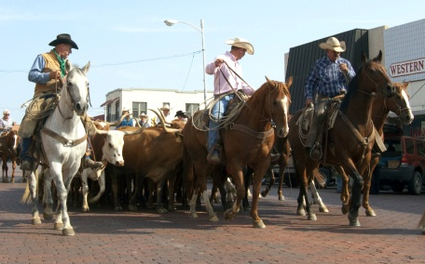
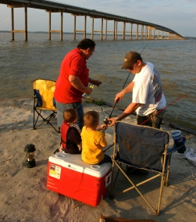
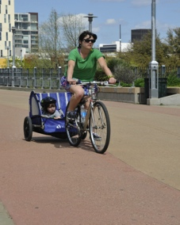
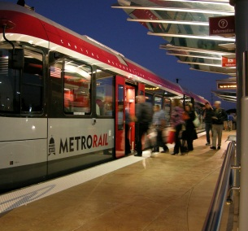
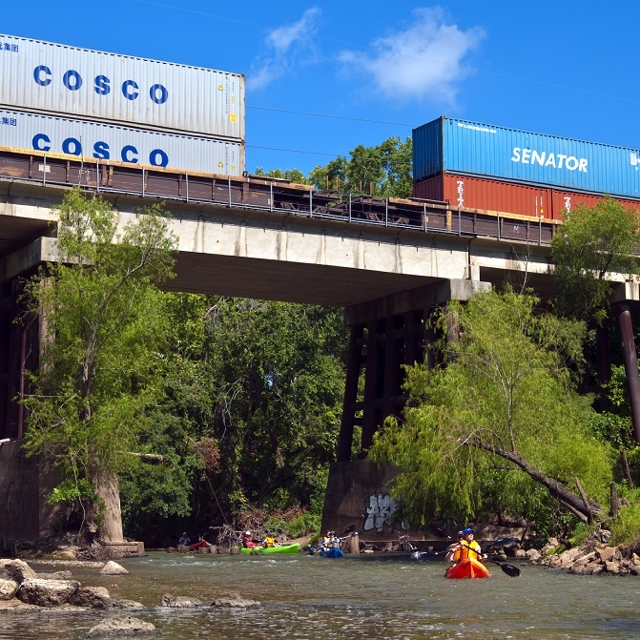
Workforce 2020
Training &Empowering the iGeneration

Slide 2
Workforce 2020
1
Characteristics
2
Values & Workplace
3
Development Implications

Slide 3
5 Generations in the Workplace
Traditionalists
Pre 1946
75 million
Baby Boomers
1946-1964
80 million
Generation X
1965-1979
60 million
iGeneration
1995-2012
72 million
Millennials
1980-1994
82 million

Slide 4
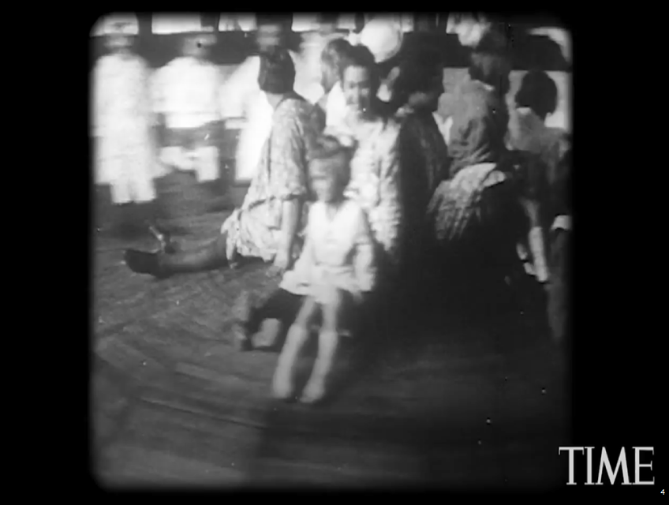
iGeneration Video
https://www.youtube.com/watch?v=nFaEPe6T_m4

Slide 5
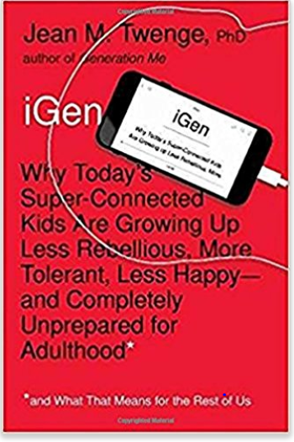

Slide 6
iGen
More time
Communicating with friends electronically
Less time
Communicating with friends in person

Slide 7
Communication

Slide 8
The Downside

Slide 9
We think of the iGen as looking at their phones
We will think of iGen other traits as time goes on

Slide 10
A quick look at history
Millennials
Baby Boomers

Slide 11
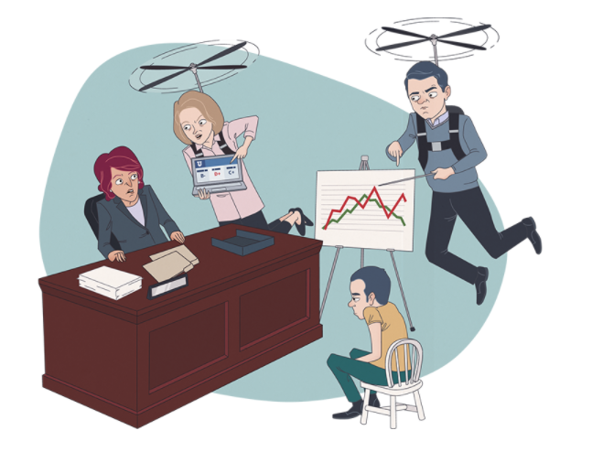

Slide 12
A quick look at history
iGeneration
Generation
X

Slide 13
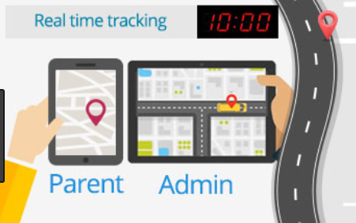
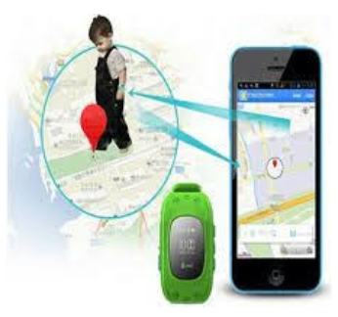
Helicopter goes high tech

Slide 14
Best Friends not Enforcers
2/3 of Gen X parents say they’re closer to their children than they were to their parents
83% of Gen X parents consider their children to be their best friends

Slide 16
Influences
Diversity
Economy
War on Terrorism
Environment
Politics
Celebrity & Media
Technology

Slide 17
iGen at Work
Phigital
Hyper-Custom
Realistic
Weconomists
DIY
Driven
FOMO

Slide 18
iGen as learners
Don’t read books
Want instant results and constant feedback
Shorter attention span
Flexibility is Key
Socially Inclined
Lack critical thinking

Slide 19
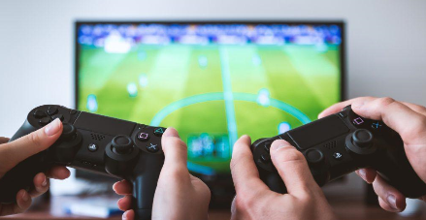
The influence of gaming

Slide 20
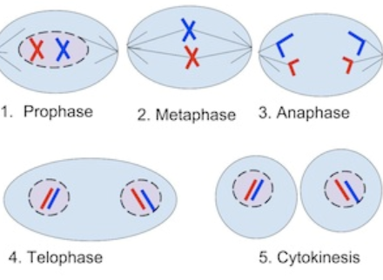
Creating Content
Assignment: Create a video that explains cell mitosis

Slide 21
Implications
What does this mean for us?

Slide 22
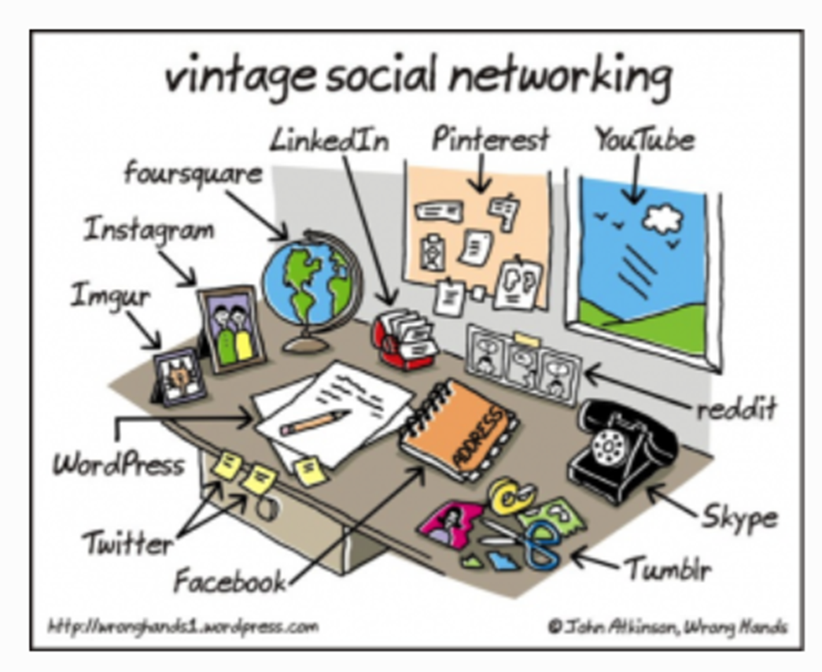
Thank-you
Laura Johannsen (Gen X)
Laura.johannsen@txdot.gov
737/529-2416
@laurajohannsen

